Slide 1



EDGE-SKILLS DEVELOPER TRAINING
Onboarding an Offering into a Data Space Using Prometheus-X
A 90-minute practical training session designed for developers and platform engineers. We walk through the full technical stack (from protocols to deployment) so you can build, integrate, and validate a real data space offering from first principles.
🕐 90 Minutes
👨‍💻 Dev Perspective
Structured, hands-on technical walkthrough
What you actually build and deploy
🔗 Protocol-Driven
Prometheus-X open source stack from the ground up
Notes:
Welcome to the EDGE-Skills Developer Training. Over the next 90 minutes, we cover what you actually build, deploy, and integrate when onboarding an offering into the EDGE-Skills data space. We work with the Prometheus-X open source stack.
The focus is on architecture, protocols, and concrete implementation, not on business logic or governance strategy. Every concept is demonstrated through a real use case.

Slide 2
What This Training Is About
This session is structured around four core design principles that shape how we teach, and how you should think about building in a data space environment.
1
2
Architecture-First Approach
Developer-Focused
We walk through the complete technical stack, layer by layer: from protocols and connectors to identity hubs and data planes. Understanding the architecture is the prerequisite to building anything meaningful.
This is not a business overview. We focus on what you actually build, deploy, and integrate, with concrete implementation references at every step.
3
4
Protocol-Driven Thinking
Hands-On Reference Case
The Prometheus-X open source stack implements DSP for interoperability and extends it with the PDI (Personal Data Intermediary) for consent-driven data sharing. DSP and DCP are currently in the ISO standardisation process.
We trace a real data sharing scenario (EDGE-Skills Skill Gap Analytics) through every component, so abstract concepts become concrete implementation decisions.
Notes:
Four guiding principles for this training. Architecture-first: we walk through the complete technical stack layer by layer. Developer-focused: what you concretely build, deploy, and integrate. Protocol-Driven Thinking: the Prometheus-X open source stack with its consent-driven PDI approach, implementing DSP for interoperability and extending it for personal data sharing.
Important note: DSP and DCP are in the ISO standardisation process. Hands-on reference case: we trace a real data sharing scenario through every component. This is not a management overview; this is a technical deep dive for developers.

Slide 3

What Is a Data Space?
Definition based on DSSC Blueprint & ISO/IEC 20151
Seven Essential Elements
What Data Spaces Are NOT
Environment, not a platform
Not data lakes or central repositories
Not central platforms or hubs
Not API gateways
Not blockchain-dependent
Not centralized identity providers
Trust through verifiable credentials
Peer-to-peer via Connectors
Governance Authority maintains rules
Key shift: You build components in a protocol-driven ecosystem, not a monolithic application. This changes everything about how you approach design and integration.
DSP, DCP protocols + PDI
Machine-readable ODRL policies
Supporting services for onboarding
Notes:
The definition is based on the DSSC Blueprint (Data Spaces Support Centre) and the emerging ISO/IEC 20151 standard. Seven essential elements: environment rather than platform, trust through verifiable credentials, peer-to-peer via connectors, a governance authority that maintains rules, DSP and DCP protocols plus the PDI (Personal Data Intermediary), machine-readable ODRL policies, and supporting services.
What a data space is NOT: not a data lake, not a central platform, not an API gateway, not blockchain-dependent, not a centralised identity provider. The key shift for developers: you build components in a protocol-driven ecosystem, not a monolithic application.
Your architecture decisions must be interoperable.

Slide 4
Why This Matters for Developers
The shift from traditional application development to data space implementation is fundamental, not cosmetic. Every assumption about how auth, data routing, and integration work must be re-examined.
Traditional
Data Space
Single monolithic application with tightly coupled components
Decentralized protocol ecosystem where each participant is sovereign
Central Auth (OAuth/API key)
Data Space
Centralized identity provider controls access
Verifiable Credentials + ODRL policies evaluated at runtime, peer-to-peer
Data Through Central Hub
Data Space
All data flows through a mediating platform
Direct peer-to-peer Data Plane transfer with no intermediary in the data path
API Integration
Data Space
Custom point-to-point integrations per partner
Prometheus-X building blocks (PDC, PDI, Consent): standardized, interoperable, automated
Notes:
Four paradigm shifts that change your thinking as a developer. From single application to decentralised protocol ecosystem: no longer a single app but distributed components communicating via standard protocols. From central auth with OAuth or API keys to verifiable credentials and ODRL policies; identity is decentralised, no central auth server.
From data through a central hub to direct peer-to-peer data plane transfer: data flows directly between participants, no central broker. From API integration to working with the Prometheus-X open source stack: instead of REST calls against a single API, you configure building blocks and consent flows.

Slide 5
The Prometheus-X Architecture
Five building blocks, consent-driven PDI; every element has a defined role in the Prometheus-X ecosystem.
Legislative Layer
Economic Layer
Technical Layer
Governance, Compliance, Legal framework. Defines the rules of participation and data use across the ecosystem.
Providers, Consumers, Marketplaces. Handles discovery, negotiation, and commercial relationships between participants.
Protocols, Connectors, Identity, Data Planes. Components: Connector (PDC), Data Planes, Identity Hub, Catalogue, Contract Service.
DSP (interop)
DCP (identity)
PDI (consent)
Control Plane ↔ Control Plane
Discovery, Negotiation, Transfer
Identity Hub ↔ Identity Hub
Credential Presentation & Verification
User ↔ Service
Consent-driven personal data sharing
Notes:
Five building blocks, consent-driven PDI: that is the Prometheus-X open source stack. The PDC Connector for peer-to-peer data exchange, Data Planes where data actually lives, the Identity Hub for credential management, the Catalogue for federated discovery, and the Contract Service for automated agreements.
Prometheus-X implements DSP as an interoperability protocol for discovery, negotiation, and transfer. DCP handles credential-based identity verification. The key differentiator is the PDI (Personal Data Intermediary), enabling consent-driven personal data sharing where individuals manage their consents from a single place.
The five components: connector (PDC), data planes, identity hub, catalogue, contract service.

Slide 6
CRITICAL DISTINCTION
Implementation ≠ Deployment
Deploying containers is not implementing a data space. A functioning data space implementation requires each of these five conditions to be true simultaneously, not just the infrastructure being up.
1
2
3
Connector Implements DSP for Interoperability
Identity Hub Presents Valid Credentials
Data Plane Handles Actual Transfer
Protocol conformance, not just reachability
Cryptographically sound, not just configured
Data flows end-to-end, not just registered
4
5
Policies Are Evaluable at Runtime
Participant Is Provisioned with Credentials
ODRL rules resolve without errors
VCs issued and stored in Identity Hub
Notes:
Deploying containers is NOT the same as implementing a data space. Five things must be fulfilled: the PDC Connector implements DSP correctly for interoperability (not just reachable, but protocol-conformant). The identity hub presents valid credentials (not just configured, but cryptographically verifiable).
The data plane handles actual data transfer (not just passing a health check). Policies are evaluable at runtime (not just defined, but enforceable). The participant is provisioned with credentials (not just registered). This is the most common confusion in data space projects.

Slide 7
Think in Protocols, Not in APIs
The Prometheus-X approach combines interoperability protocols with its own consent-driven architecture. DSP and DCP provide cross-data-space compatibility, while the PDI is the distinctive Prometheus-X component for personal data sharing.
Dataspace Protocol (DSP)
Decentralized Claims Protocol (DCP)
Service Chain Protocol
Catalog Discovery: Consumer queries Provider's offerings dynamically
Contract Negotiation: REQUESTED → OFFERED → AGREED → VERIFIED → FINALIZED
Transfer Coordination: Control Plane orchestrates Data Plane activation
Multi-participant data flows orchestrated across organisations
Orchestrator builds visual service chains (PDC v1.9+)
Data + Service + Infrastructure offers combined end-to-end
Peer-to-peer credential exchange, no central authority
Credentials sourced from Identity Hub
Cryptographic verification at every step
HTTPS + JSON-LD | Machine-to-machine | Zero-trust
Notes:
The Prometheus-X approach in detail. DSP (Dataspace Protocol) is implemented as an interoperability protocol: catalogue discovery where the consumer queries the provider’s offerings, contract negotiation through the state machine REQUESTED, OFFERED, AGREED, VERIFIED, FINALIZED.
Transfer coordination where the control plane orchestrates data plane activation. All via HTTPS and JSON-LD, machine-to-machine, zero-trust. DCP (Decentralised Claims Protocol) handles peer-to-peer credential exchange for cross-data-space identity interoperability.
Credentials come from the identity hub and are cryptographically verified. The PDI (Personal Data Intermediary) is Prometheus-X’s key differentiator, enabling consent-driven personal data sharing where individuals centrally manage, audit, and revoke permissions. The Service Chain Protocol enables multi-participant data flows orchestrated across organisations. Using the Orchestrator component (available from PDC v1.9), participants can chain Data Offers, Service Offers, and Infrastructure Offers into visual processing pipelines. Use-case logic is defined per Data Space, allowing flexible composition of analytics, transformation, and enrichment services.

Slide 8




The Four Layers Developers Must Understand
Each layer has a distinct responsibility. Mixing concerns (especially trust decisions with data movement) is one of the most common implementation mistakes.
1. Control Plane
2. Data Plane
3. Identity Hub
4. Tenant Management
The PDC implements DSP for catalogs, negotiations, contracts, and ODRL policy evaluation. This is the governance brain of your participant node.
Where actual data moves: Pull, Push, or Stream. Exposes REST APIs via PDC. Interoperable with EDC SDKs in Go, Java, Rust, and .NET.
Manages DIDs (did:web), stores Verifiable Credentials, and composes DCP proofs for peer-to-peer credential exchange. DCP is used for cross-data-space identity interoperability.
Handles multi-tenant lifecycle and participant provisioning. Not in the trust decision path: trust happens directly between Connectors.
Notes:
Four technical layers you must master as a developer. First, the control plane: the PDC with catalogues, negotiations, contracts, and ODRL policy evaluation, implementing DSP for interoperability. This is the brain. Second, the data plane: actual data transfer via pull, push, or stream.
REST APIs via PDC. This is the muscle. Third, the identity hub: DIDs using did:web, verifiable credentials, and credential proof composition for identity verification. Fourth, tenant management: multi-tenant lifecycle (and critically: NOT in the trust decision path).
Trust decisions happen directly between connectors peer-to-peer.

Slide 9
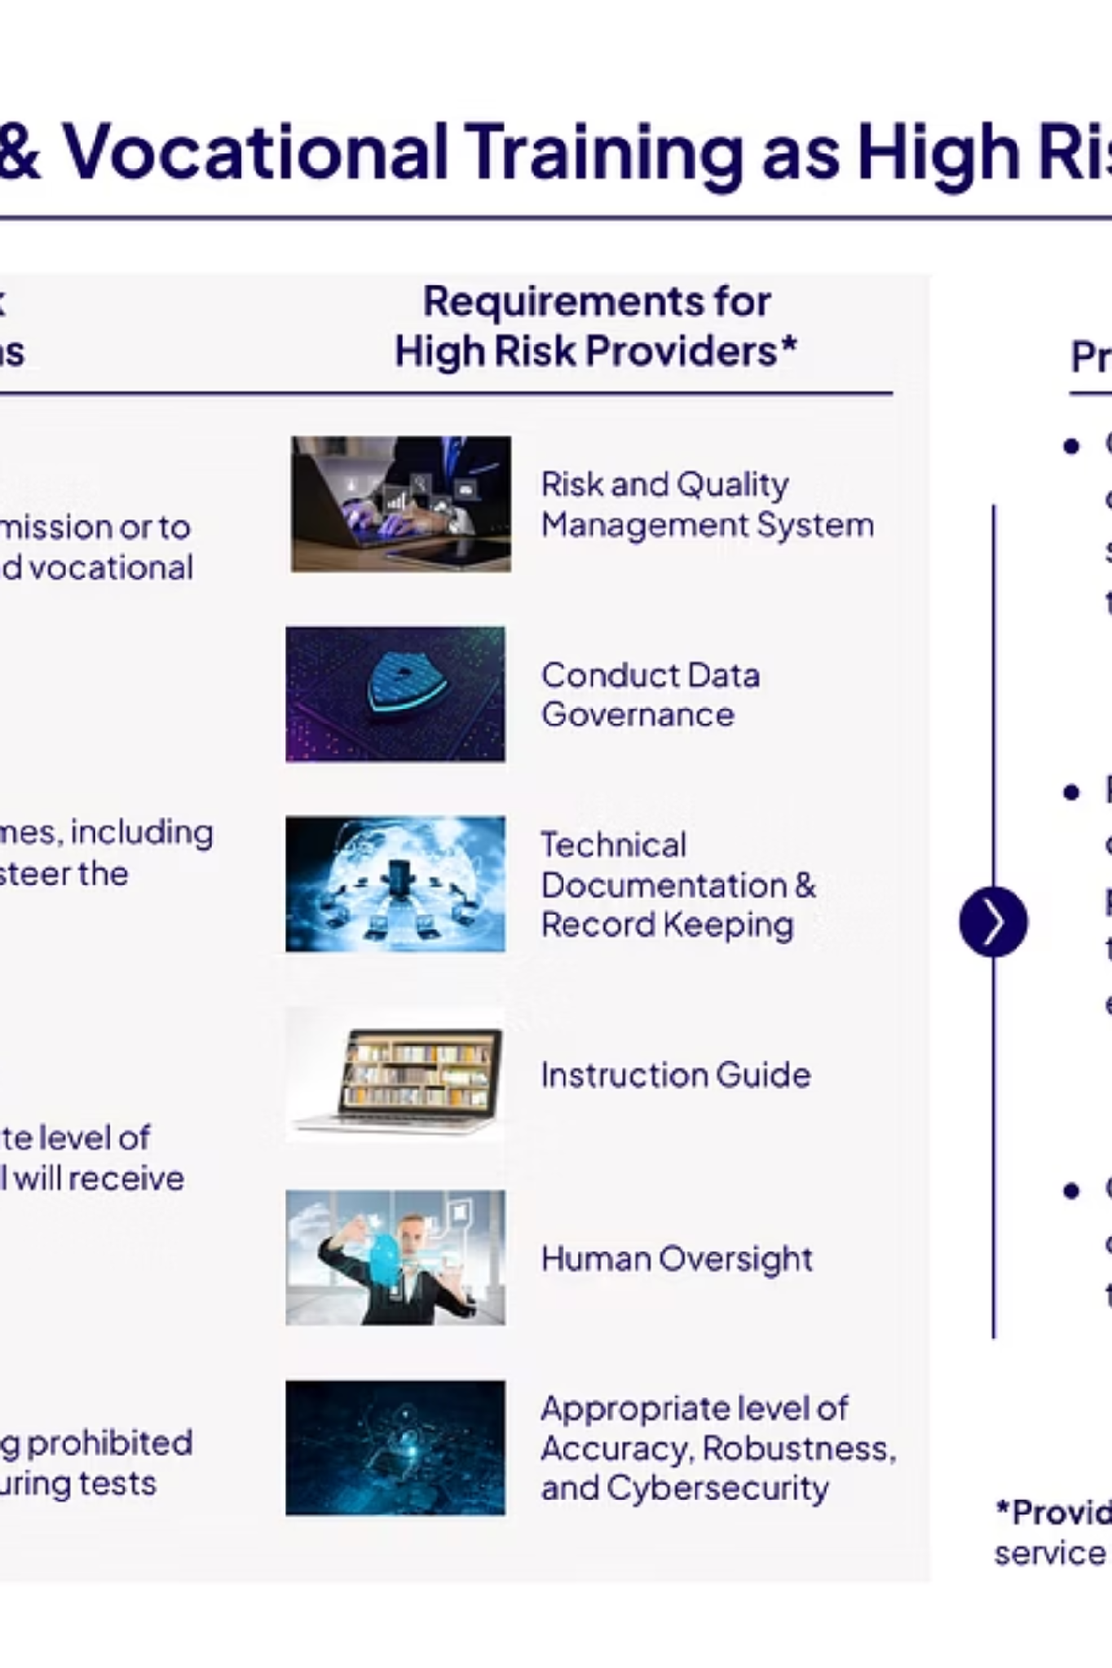
EDGE-Skills Use Case: Skill Gap Analytics
01
The EDGE-Skills Project
EU-funded data space for education and skills, led by Prometheus-X with 36 organizations across 8 EU countries. A real production-grade ecosystem.
02
The Use Case
Schülerkarriere shares anonymized student skills profiles; imc consumes them for skill gap analysis, a cross-organizational analytics workflow with GDPR compliance.
03
Data Flow
Student profiles (interests, competencies, learning progress) → Analytics service → Personalized skill gap reports delivered to students and employers.
04
Why This Use Case
Combines personal data protection (GDPR), sovereign data sharing, and cross-organizational analytics, the full complexity of a real data space scenario.
Notes:
The EDGE-Skills project: an EU-funded data space for education and skills, led by Prometheus-X with 36 organisations across 8 EU countries. Our use case: Schülerkarriere shares anonymised student skill profiles, imc consumes them for skill gap analysis.
The data flow: student profiles with interests, competencies, and learning progress flow through an analytics service to personalised skill gap reports for students and employers. Why this use case: a real EDGE-Skills scenario combining personal data protection under GDPR, sovereign data sharing, and cross-organisational analytics, all the technical challenges at once.

Slide 10
REFERENCE CASE
Skill Gap Analytics for Students
Hub A: Provider
Hub B: Consumer
Hub C: End Customer
Schülerkarriere: Student career platform. Publishes anonymized student skills profiles into the data space.
imc: Analytics service provider. Consumes skills data to generate personalized skill gap reports.
Students & Employers benefit from personalized gap reports that match learning outcomes to real labor market needs.
Trust Model: Access controlled by Verifiable Credentials + GDPR consent. Policy: Any organization with valid Membership and Data Processing Credentials can access the skills data. No identity checks, no API keys, no manual approvals.
Notes:
The three hubs in detail. Hub A (provider): Schülerkarriere as student career platform, publishes anonymised skill profiles. Hub B (consumer): analytics service provider, consumes skills data for gap analysis. Hub C (end customer): students and employers, benefit from personalised skill gap reports.
The trust model: access is controlled by verifiable credentials plus GDPR consent. The policy: any organisation with valid membership and data processing credentials can access the skills data. No identity checks, no API keys, no manual approvals; everything automated through the protocol.

Slide 11
Step 1: The Connector (Control Plane)
The PDC Connector is the central software agent representing a participant in the data space. It implements DSP for interoperability, evaluates policies, and orchestrates trust, but never touches data directly.
Catalog Publication
Contract Negotiation
Dynamically generates catalogs based on Consumer credentials. Different Consumers see different offerings; no static catalog files.
Verifies credentials and evaluates ODRL policies. Produces binding Contract Agreements through the contract negotiation process.
Policy Evaluation
Transfer Coordination
ODRL policies evaluated at runtime on every interaction; no redeployment needed when rules change.
Selects the appropriate Data Plane and issues authorization signals. The Connector never handles data directly.
Deployment options: Standalone (one per org) or Multi-Tenant via PDC Tenant Manager.
Notes:
The connector is the central software agent representing a participant in the data space. Four core functions: catalogue publication: a dynamic catalogue based on consumer credentials. Different consumers see different offerings.
Contract negotiation: verify credentials, evaluate policies, produce binding contract agreements. Policy evaluation: ODRL policies evaluated at runtime without redeployment. Transfer coordination: selects the data plane and issues authorisation signals.
Never handles data directly. Deployment options: standalone with one connector per organisation, or multi-tenant via PDC.

Slide 12
Step 2: Build and Register a Data Plane
The Data Plane is where actual data moves, and the only place you'll write significant custom code in a typical implementation.
Pull
Push
Stream
Consumer fetches from Provider on demand. Typical for APIs and database queries.
Provider sends to Consumer proactively. Typical for batch exports and file transfers.
Continuous data flow. Typical for IoT telemetry and real-time event streams.
Architecture Principles
Registration via PDC
Placement flexibility: operate where your data lives
Protocol diversity: specialize per data type
Independent scaling: no impact on governance or policies
Security boundaries: trust decisions stay in Control Plane
Register via POST with the URL endpoint for signaling and the supported source/transfer types. Interop via EDC SDKs in Go, Java, Rust, and .NET.
For simple file/JSON over HTTP: minimal custom code needed. The PDC handles the rest.
Notes:
The data plane is where actual data moves, and where you write custom code. Three transfer patterns: pull: consumer fetches from provider via APIs and queries. Push: provider sends to consumer via batch exports and files.
Stream: continuous flow for IoT and telemetry. Architecture principles: placement flexibility: operate the data plane where data lives. Protocol diversity: specialised data planes for different protocols. Independent scaling: no impact on policies.
Security boundaries: trust is separate from data. Integration via REST APIs through PDC, interoperable with EDC SDKs in Go, Java, Rust, and .NET. For simple file or JSON sharing over HTTP, you need minimal custom code.

Slide 13

Data Plane and Transfer Lifecycle (EDC Interoperability)
The Data Plane handles the actual data transfer lifecycle between participants (EDC-based data planes). Understanding the state transitions (initiate, start, suspend, terminate) is critical for debugging and building robust Data Planes.
SERVE
SUSPEND
Data Plane serves data to Consumer.
Optional pause before resuming or ending.
START
TERMINATE
Control Plane initiates transfer.
End of transfer and resource cleanup.
Endpoint Data References (EDR)
Capability Registration
After successful negotiation, the Consumer receives an EDR containing a time-limited access token and endpoint URL. The Data Plane validates the token before serving any data: no token, no data.
Data Planes declare their supported source types and transfer types at registration time. The Control Plane routes each transfer to the correct Data Plane based on declared capabilities.
Deploy anywhere: On-prem, VMs, Cloud, or Managed infrastructure.
Notes:
The four data plane lifecycle signals (EDC-based data planes): START: control plane initiates the transfer. SERVE: data plane serves data. SUSPEND: optional pause. TERMINATE: end transfer. Endpoint data references: after successful negotiation, the consumer receives an EDR containing endpoint URL and a time-limited access token.
The data plane validates the token before serving any data. Capability registration: data planes declare their supported source types and transfer types. The control plane routes transfers to the right data plane based on capabilities.
Deployment options: on-premises, VMs, cloud, or managed.

Slide 14

Step 3: Identity Hub & Decentralized Identity
Each participant's credential wallet: managing DIDs, storing Verifiable Credentials, and composing cryptographic proofs for peer-to-peer trust.
DID Management
Credential Storage
Creates did:web identifiers, manages signing keys, and publishes DID Documents to the web for resolution by any participant.
Stores Membership Credentials, Attribute Credentials, and Role-specific Credentials. The hub is the participant's authoritative credential source.
Proof Composition
Verification
Selects relevant credentials and composes cryptographic presentations for peer-to-peer identity verification, with no central authority in the loop.
Checks signatures, validity periods, revocation status, and trust anchors, all at runtime during negotiation and transfer.
Trust Sequence: DID Creation → Credential Acquisition → Hub Storage → Proof Presentation → Verification → Policy Evaluation
Notes:
The identity hub is each participant's wallet for credentials and DIDs. Four areas: DID management: creates did:web identifiers, manages signing keys, and publishes DID documents. Credential storage: membership credentials, attribute credentials, and role-specific credentials.
Proof composition: selects relevant credentials, creates cryptographic presentations for peer-to-peer identity verification without central authority. Verification: checks signatures, validity, revocation status, and trust anchors. The trust sequence: DID creation, credential acquisition, hub storage, proof presentation, verification, policy evaluation.
That is the complete identity lifecycle.

Slide 15
Verifiable Credentials & Trust Anchors
Trust in a data space is attribute-based, not identity-based. You don't prove who you are; you prove what you are entitled to do.
Verifiable Credential Structure
Five Policy Levels Using Credentials
Claims: what is attested about the holder
Issuer Identity: who cryptographically signed it
Cryptographic Proofs: tamper-evident signature
Validity Periods: explicit expiration dates
Trust: Trust contexts
Segmentation: Catalog visibility by credential
Access: Data sharing requirements
Credential Lifecycle
Issuance → Storage → Presentation → Verification → Renewal → Revocation. Trust Frameworks (e.g., Gaia-X, EBSI) define which issuers and credential types are accepted.
Contract: Sharing agreements
Usage: Post-transfer rules
Notes:
The central concept: trust is attribute-based, not identity-based. Credential structure: claims (what is attested). Issuer identity (who signed it). Cryptographic proofs (verifiable signature). Validity periods (expiration date).
Lifecycle: issuance, storage, presentation, verification, renewal, revocation. Trust frameworks such as Gaia-X and EBSI define which issuers and credential types are trusted. Five policy levels using credentials: segmentation (catalogue visibility by credential).
Access (data sharing requirements). Usage (post-transfer rules). Contract (sharing agreements). Trust (trust contexts).

Slide 16

Step 4: Define Policies with ODRL
ODRL policies are machine-readable rules evaluated at runtime. Change a policy and the effect is immediate; no code changes, no redeployment needed.
Three Evaluation Points
ODRL Control Mechanisms
Broad Access: Any active member
Credential-based: Specific certification required
Bilateral: This specific partner only
Framework-governed: Members who accepted Agreement X
1. Catalog Discovery
Access policies filter what each Consumer sees in the catalog based on their credentials.
2. Contract Negotiation
Change one policy → immediate effect. No code changes, no redeployment.
Contract policies verify that the Consumer holds the required credentials before an agreement is finalized.
3. Transfer Execution
Usage policies govern what the Consumer may do with the data after transfer is complete.
Notes:
Machine-readable rules evaluated at runtime. Three evaluation points: at catalogue discovery, access policies filter what consumers see. At contract negotiation, contract policies verify credentials. At transfer execution, usage policies govern data use.
ODRL control mechanisms in four tiers: broad access for all active members. Credential-based for specific certifications. Bilateral for a specific partner only. Framework-governed for members who accepted a particular agreement.
The key advantage: ODRL policies can be updated at runtime; change one policy and it takes immediate effect, no code change, no redeployment needed.

Slide 17



Step 5: Publish Data
Publishing data in a data space means creating three Control Plane objects. The actual data never leaves your Data Plane; the Control Plane holds only governance metadata.
1. Create Asset
2. Define Policy
3. Contract Definition
Metadata (ID, type, product description) + a DataAddress pointing to the Data Plane endpoint. The Control Plane holds only the pointer, never the data.
An ODRL policy specifying access requirements. Credential-based authorization: who holds what credential may negotiate for this asset.
Links the Asset to the Policy. Makes the offering discoverable and negotiable in the catalog. Without this object, no Consumer can find your data.
The actual data stays on the Provider's Data Plane at all times. The Control Plane holds only governance: metadata, policies, and contract state.
Notes:
Three control plane objects for publication. First: create asset: metadata including ID, type, and product plus DataAddress pointing to the data plane. The control plane holds only metadata, no data. Second: define policy: ODRL policy specifying access requirements with credential-based authorisation.
Third: contract definition: links asset and policy. Makes the offering discoverable and negotiable in the catalogue. The central principle: the actual data stays on the provider's data plane. The control plane holds only governance.
This is the core principle of data sovereignty.

Slide 18
Step 6: Consume Data
Consuming data follows a strict three-step protocol sequence. No portal logins, no API keys, no manual approvals; everything is credential-driven and automated.
1
2
3
Catalog Discovery
Contract Negotiation
Transfer Initiation
Query the Provider's catalogue endpoint. The catalog is generated dynamically based on your credentials; you only see what you're entitled to see. No custom code required on the Consumer side.
State machine: REQUESTED → AGREED → VERIFIED → FINALIZED. Completes in seconds with zero human intervention. Credentials are verified, policies evaluated, and a binding agreement is produced.
Receive an EDR (endpoint URL + time-limited access token). Use the token to retrieve data directly from the Provider's Data Plane. The token is validated by the Data Plane before any data is served.
For Providing Data
For Consuming Only
Deploy your own Data Plane in addition to the Connector
A standard Connector is sufficient; no Data Plane required
Notes:
The three-step data consumption protocol. Catalogue discovery: query the provider’s catalogue endpoint. The catalogue is generated dynamically based on consumer credentials. Key characteristics: no portal accounts, no API keys, no custom code, no manual approvals, standardised across all providers.
Contract negotiation: REQUESTED, AGREED, VERIFIED, FINALIZED. Seconds, no human intervention. Transfer initiation: receive EDR with endpoint and token, retrieve data directly from the provider's data plane. For providing data: deploy your own data plane.
For consuming only: a standard connector is sufficient.

Slide 19
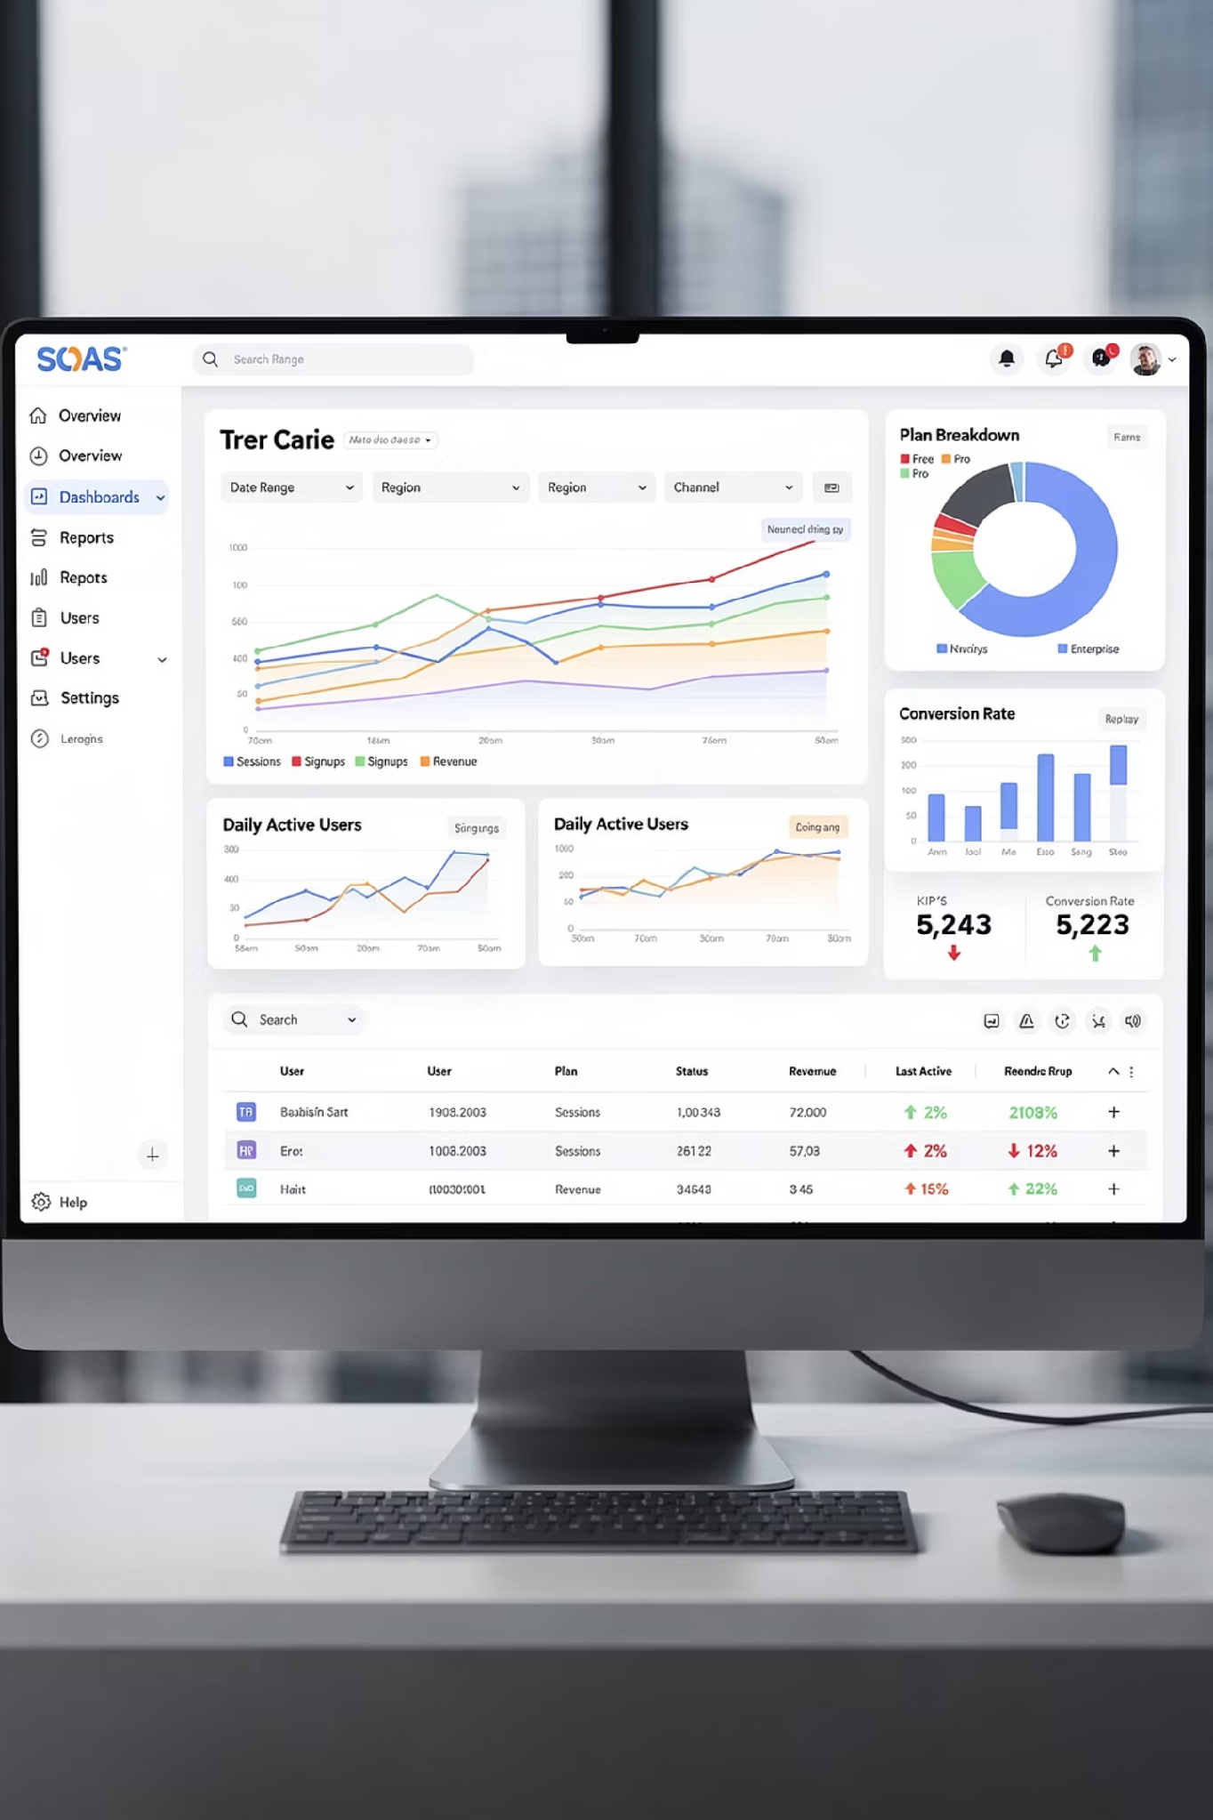
REFERENCE IMPLEMENTATION
VisionsTrust
VisionsTrust is a Prometheus-X Implementation Reference: a SaaS platform implemented using the Prometheus-X open source stack for discovery (catalog), contracts, consent, and data exchange.
Catalogue
Contract Service
Discovery, onboarding, and configuration dashboards for managing your data space presence.
Negotiation workflows, digital signatures, and policy management across the full agreement lifecycle.
Consent Service
Individual consent management, data exchange triggers, and privacy notice delivery for personal data flows.
Notes:
VisionsTrust is the SaaS reference implementation of the Prometheus-X building blocks for discovery, contracts, consent, and data exchange. Three core services: the catalogue for discovery, onboarding, and configuration dashboards.
The contract service for negotiation, signatures, and policy management. The consent service for individual consent and data exchange triggers. As a developer, VisionsTrust is your concrete implementation reference; here you see how the abstract protocols are realised in a production platform.

Slide 20
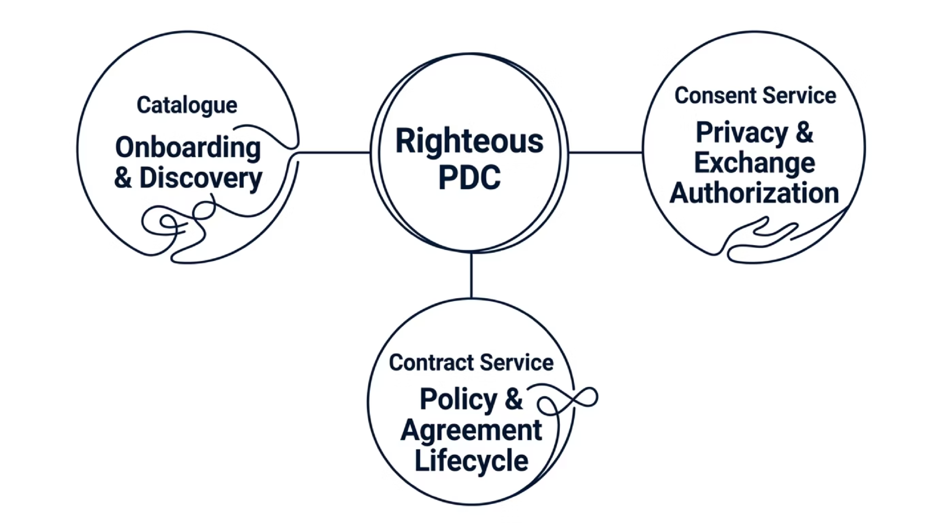


VisionsTrust Architecture Overview
How the three services connect through the Prometheus-X Dataspace Connector (PDC). The PDC is the integration point; all three Building Blocks communicate through it.
Verification: After PDC setup, check Settings → Endpoints tab to confirm your HTTPS domain appears. This confirms your Connector has successfully auto-registered with VisionsTrust.
Notes:
How the three services connect through the Dataspace Connector PDC. The catalogue: participant onboarding, offer and resource management, project discovery, marketplace browsing. The contract service: contract negotiation, policy evaluation, signature management, agreement lifecycle.
The consent service: consent records, privacy notices, user registration, exchange authorisation. Everything runs through the PDC as the central coordination layer. Important verification step: after PDC setup, check Settings, then Endpoints tab to confirm your HTTPS domain appears correctly.

Slide 21
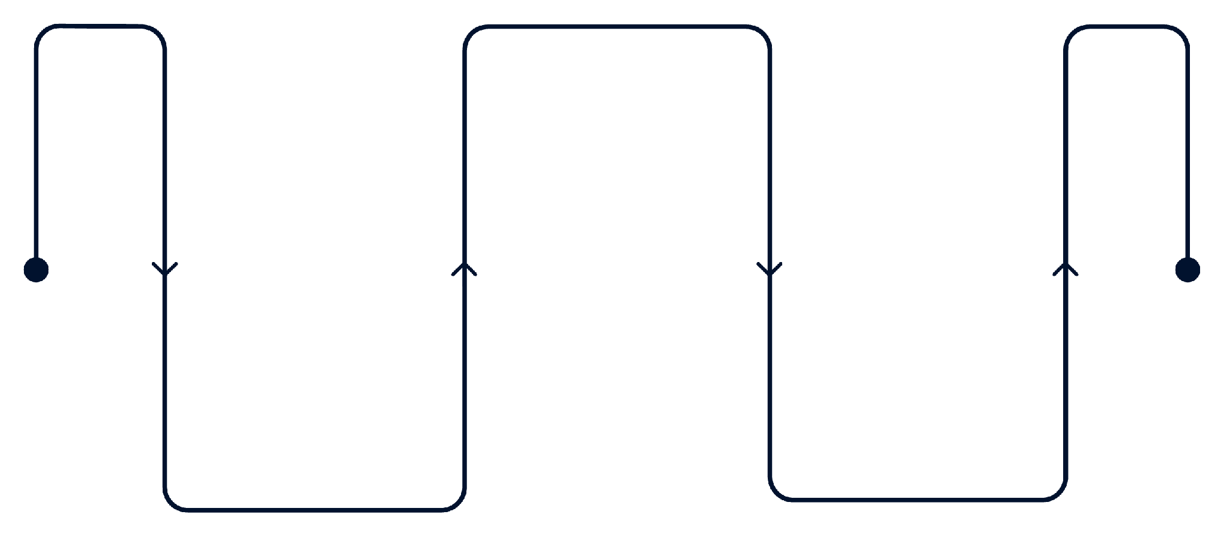
Setting Up the Dataspace Connector (PDC)
The PDC is the integration core: it enforces contracts, evaluates policies, manages consent, and communicates with all Prometheus-X services on your behalf.
Auto-Register
PDC registers automatically with VisionsTrust
Verify
Configure PDC
Check Settings > Endpoints for HTTPS domain
Connect to Catalogue, Contract, Consent
Auto-Registration
Optional: Credentials
Once configured, your PDC automatically registers with VisionsTrust. No manual registration step required. Verify success via Settings → Endpoints; your HTTPS domain should appear there.
Resources can have associated credentials generated through the PDC. When referencing credentials in resource metadata, always use credential identifiers, never actual credential values. This keeps secrets out of metadata records.
Notes:
The PDC enforces contracts, evaluates policies, manages consent, and communicates with the Prometheus-X services. Six configuration parameters: endpoint: your own HTTPS domain. catalogUri, contractUri, consentUri: the fixed VisionsTrust endpoints. serviceKey and secretKey: your unique keys from the VisionsTrust dashboard under Settings.
Auto-registration: once configured, your PDC automatically registers with VisionsTrust. Verify via Settings, then Endpoints. Optional: credentials can be generated through the PDC. Use credential identifiers in metadata, never the actual values.

Slide 22
The Complete Onboarding Flow
Onboarding has two parallel tracks: a non-technical track for the data provider organization, and a technical track for the developer deploying the infrastructure. Both must complete successfully for exchanges to work.
Non-Technical (Provider)
Technical (Developer)
01
02
01
02
Register on VisionsTrust: Create account as a data space participant
Create an Offer: Bundle resources into a catalogue product
Deploy PDC: Prometheus-X Dataspace Connector
Configure PDC: Connect to Catalogue, Contract, Consent services
03
04
Verify Connectivity: Ping from Settings → Endpoints
Publish to Catalogue: Make offer discoverable to the ecosystem
03
04
Add Data/Service Resources: Define metadata, type, location, and sample
Set Up Representations: Source type, URL, credentials for each resource
05
Test in Tech Space: Validate exchanges with test PDCs
Notes:
Two parallel paths: non-technical for the provider and technical for the developer. Provider side: register on VisionsTrust, create offer bundling resources as a catalogue product, add data and service resources with metadata, type, location, and sample, then publish to catalogue.
Developer side: deploy PDC, configure PDC for catalogue, contract, and consent, verify connectivity via ping under Settings then Endpoints, set up representations with source type, URL, and credentials, then test in Tech Space with test PDCs.
Both paths must be synchronised; this is the PM-developer interface.

Slide 23
Resources, Offers, and the Catalogue
Understanding the distinction between a Resource and an Offer is foundational. Resources are the raw metadata units. Offers are the packaged products that appear in the catalogue. Resources alone are never discoverable.
Resource
Offer
An individual metadata unit describing a single dataset, API, or service. Defines what data is available, where it lives, and how to access it. Never appears directly in the catalogue.
Bundles one or more Resources into a discoverable product. The Offer is what Consumers find, negotiate, and contract against in the catalogue.
Technical Representations (Tech Tab)
Field
Value
Notes
Source Type
HTTP REST
Protocol used for PDC interaction
URL
Your endpoint
Where the PDC retrieves data from
Security
None or API-Key
Use credential identifiers, not actual values
Payload
Optional
For API consumption flow configuration
Notes:
Key distinction: a resource is an individual metadata unit. An offer bundles resources into a discoverable product. Resources alone never appear in the catalogue. Mandatory fields: resource name, resource type, description, data location, anonymised extract as JSON sample, and if applicable the personal data flag.
The personal data flag triggers consent requirements and requires the userId parameter in the endpoint. Technical representations in the tech tab: source type is HTTP REST, URL is the endpoint for data retrieval, security is none or API-key using credential identifiers, payload for API consumption flow configuration.

Slide 24
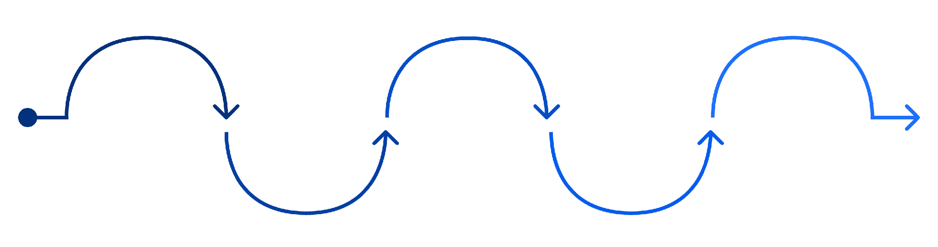
Projects, Contracts & Negotiation
No data exchange is possible without a signed project contract. The project is the governance scope; all participants, offers, and exchanges live within it.
Invite Providers
Create Project
Negotiate Terms
Sign Contract
Exchange Data
Orchestrator defines scope
Or providers request to join
Mandatory for all participants
Review and counter-offer cycle
Offers activate upon signing
Negotiation Cycle
Key Terms
Orchestrator invites provider to project
Provider reviews proposed terms
Either party may modify and counter
Cycle repeats until agreement is reached
Provider signs → Offers activate for exchange
Participant: Entity with a data space identifier
Project: Scoped ecosystem for data exchanges
Orchestrator: Manages project, builds service chains
Contract: Data sharing agreement between members
Notes:
No data exchange without a signed project contract. The flow: create project, invite providers or providers request to join, negotiate terms with modify and counter-offer, sign contract as mandatory for all participants, then exchange data with active offers.
The negotiation cycle in detail: orchestrator invites provider, provider reviews terms, either party can modify and counter, cycle repeats until agreement, provider signs contract and offers activate. Key terms: participant as entity with data space identifier, project as scoped ecosystem for data exchanges, orchestrator manages project and builds service chains, contract as data sharing agreement between members.

Slide 25
Four Data Exchange Protocols in Practice
VisionsTrust supports four distinct exchange patterns. Choosing the right one determines how you configure your resource, how the PDC routes the exchange, and what infrastructure you need.
B2B Non-Personal
Consent-Driven
Direct org-to-org data sharing. No consent required. Authorization is contract-based only. The simplest exchange type, ideal for organizational datasets.
Individual consent required. Involves the PDI consent service. Endpoint must include {userId}. Resource must be flagged as personal data. Required for GDPR-covered flows.
API Consumption
Service Chains
Data Provider consumes a service. Resource marked as API payload. PDC adjusts exchange protocol accordingly. Response is sent back to the Provider after service execution.
Multi-participant workflows where an Orchestrator builds the chain visually. Combines Data, Service, and Infrastructure offers. Requires PDC v1.9.0+.
Notes:
Four exchange types for different scenarios. B2B non-personal: direct organisation-to-organisation data sharing, no consent needed, contract-based authorisation only, simplest exchange type. Consent-driven: individual consent required, PDI consent service involved, endpoint must include userId, resource flagged as personal data.
API consumption: data provider consumes services, resource marked as API payload, PDC adjusts exchange protocol, response sent back to provider. Service chains: multi-participant workflows, orchestrator builds chain visually, data plus service plus infrastructure offers, requires PDC v1.9.0+.

Slide 26

Testing with VisionsTrust Tech Space
The Tech Space is a dedicated testing environment with VisionsTrust-controlled test PDCs. Validate your integration before going live in the production ecosystem.
Supported Exchange Tests
Testing Tools
Project Exchange: 1-to-1 contract-based
Service Chain: Multi-participant flows
Ping Connector: Verify PDC connectivity end-to-end
Log Viewer: Monitor exchange logs in real time
CSV Export: Download logs for offline troubleshooting
Custom Parameters: Define exchange parameters with payload examples
Exchange Triggers: Launch exchanges directly from the platform (PDC v1.10.0+)
API Consumption: Per PDC protocol specs
Consent-Driven: With personal data simulation
Before testing, verify that your PDC is reachable via HTTPS from the internet, your resource URL is accessible, and your contract with the Tech Space test PDC is in FINALIZED state.
Notes:
Dedicated testing environment with VisionsTrust-controlled test PDCs. Four supported exchange tests: project exchange for one-to-one contract-based, service chain for multi-participant flows, API consumption per PDC protocol specification, consent-driven with personal data simulation.
Testing tools: ping connector for PDC connectivity, log viewer for real-time monitoring, CSV export for troubleshooting, custom parameters for exchange parameters with payload examples, exchange triggers from PDC v1.10.0+.
Common configuration errors: missing tech config: set REST source type and endpoint URL in data representation. Missing API flow: check resource API box. Missing PII declaration: enable personal data flag and add userId query parameter.

Slide 27
Operational Tooling for Data Spaces
Tools and capabilities for managing Prometheus-X data spaces in production, from asset registration to compliance reporting and ecosystem visualization.
Data Catalog
Data Spaces
Register, classify, and manage assets. Data sources connected via PDC: HTTP/REST endpoints, file storage, and cloud services.
Browse federated spaces and participants. Negotiate agreements and manage ongoing data exchanges across ecosystem partners.
Connections & Transfers
Compliance & Governance
Monitor data movement and status in real time. Full visibility into active, completed, and failed transfer operations.
DPP, CSRD, AI Act, LkSG, EUDR, DGA. Policy Engine for classification and enforcement. Multi-license management with conflict detection. Graph View for ecosystem visualization.
Notes:
Tools and capabilities for managing Prometheus-X data spaces in production. Eight areas: data catalogue for asset registration and classification. Data spaces for browsing federated spaces and participants. Connections for agreement negotiation and exchange management.
Transfers for monitoring data movement and status. Compliance for DPP, CSRD, AI Act, LkSG, EUDR, and DGA. Governance for classification, policy enforcement, and quality scores. Policy engine for multi-licence management and conflict resolution.
Graph view for network visualisation of the ecosystem. Data sources connected via PDC: HTTP/REST endpoints, file storage, cloud services.

Slide 28
Multi-Tenant Deployment with PDC
The PDC Tenant Manager enables scalable multi-tenant operations, managing multiple participant contexts from a single deployment without compromising trust isolation.
Critical: PDC Tenant Manager is NOT in the trust decision path. Trust decisions happen directly between Connectors peer-to-peer. The Tenant Manager only handles provisioning and lifecycle.
Two-Step Provisioning
4 Sequential Activity Agents
Step 1: Create Tenant: POST with tenant-ID, display name, and description.
Step 2: Deploy Participant Profile: Bind DID + Dataspace Profiles to the tenant context.
01
02
IDP Agent: Provisions OAuth2 clients
PDC Agent: Creates participant contexts
03
04
Components
Registration Agent: Sets up Credential Issuer
Onboarding Agent: Issues VCs and stores them
Tenant Manager | Provision Manager | NATS + PostgreSQL
Notes:
The PDC Tenant Manager for scalable operations. Important upfront: the PDC Tenant Manager is NOT in the trust decision path. Trust decisions happen directly between connectors peer-to-peer. Two-step provisioning: step 1: create tenant with POST including tenant-ID, display name, and description.
Step 2: deploy participant profile with DID binding and Dataspace Profiles. Four sequential activity agents: IDP agent for OAuth2 clients, PDC agent for participant contexts, registration agent as credential issuer, onboarding agent for VCs and storage.
Components: tenant manager, provision manager, NATS, and PostgreSQL.

Slide 29
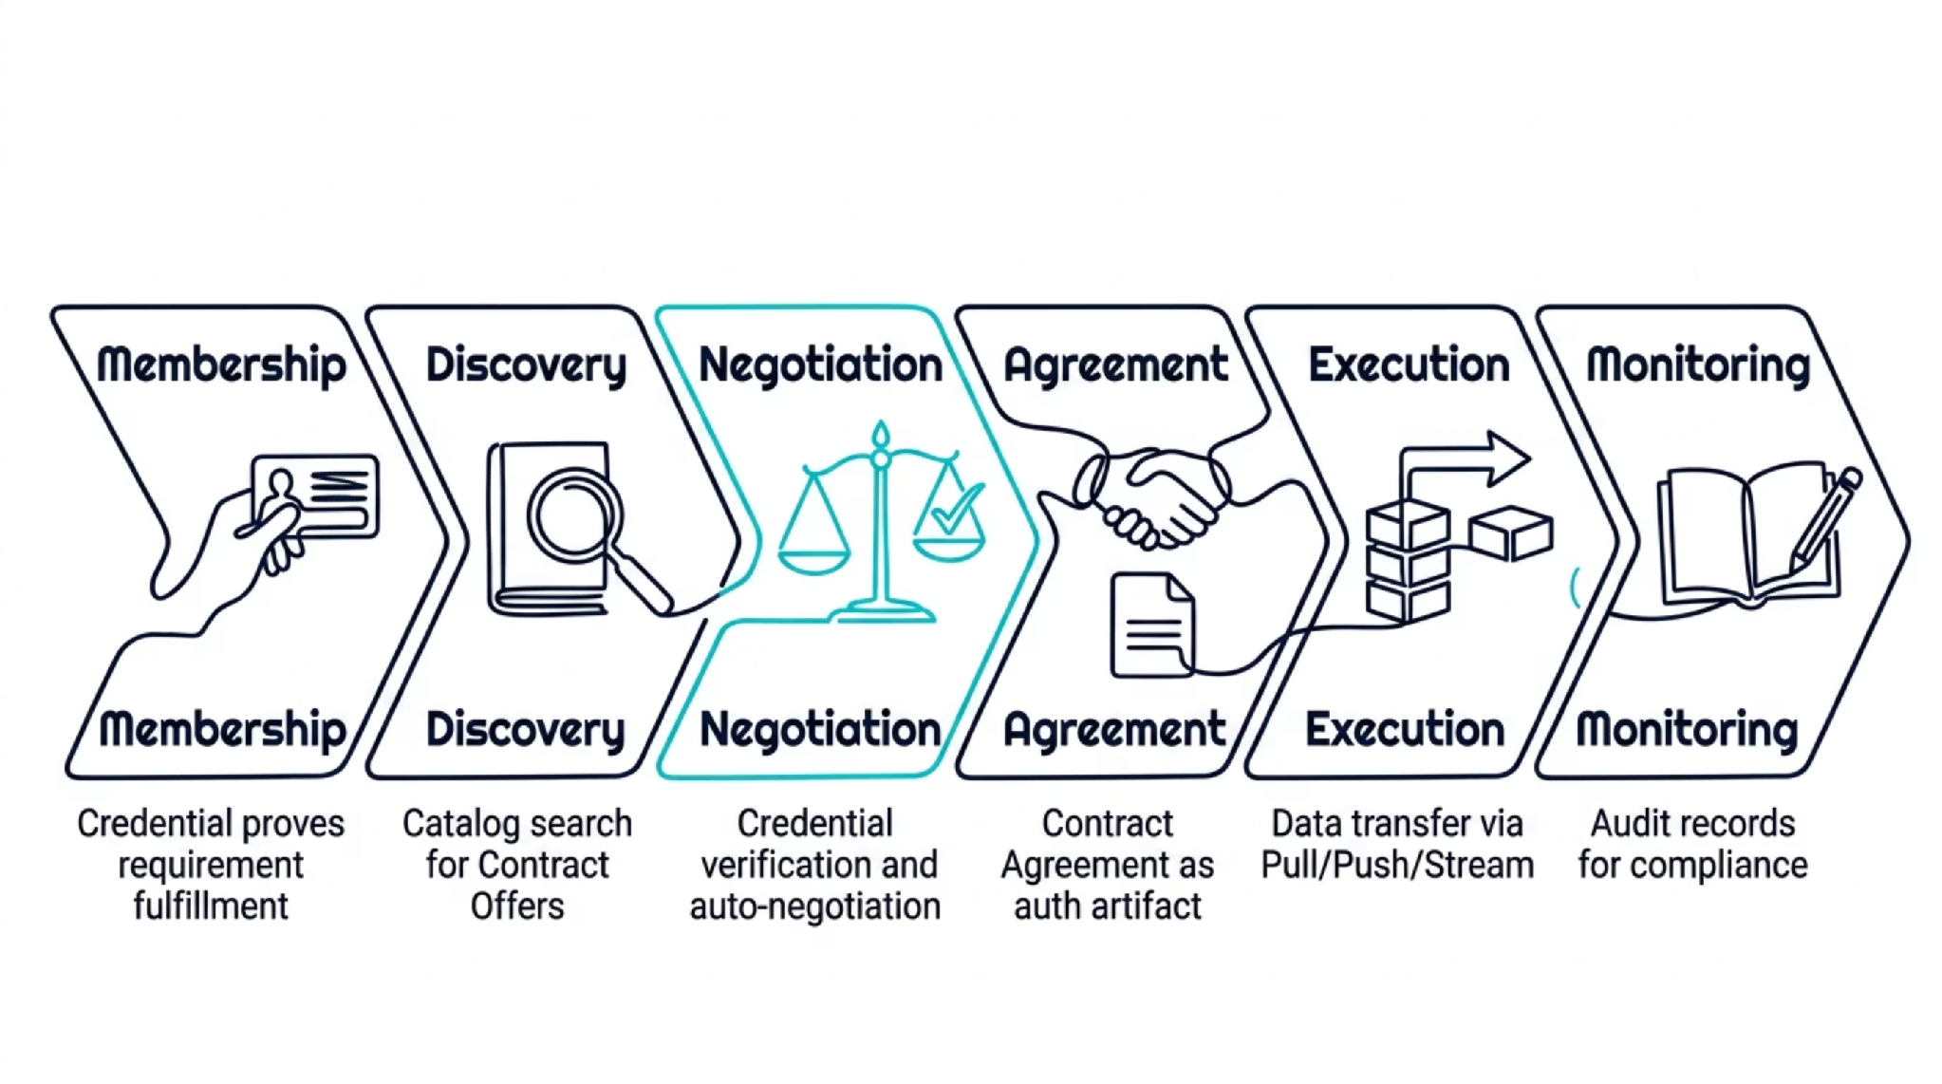
Step 7: Validate the Full Flow End-to-End
Individual component tests are necessary but not sufficient. The full chain must work together; a Contract Agreement that cannot produce a successful data transfer is not a working implementation.
Validation Checklist
Can a Consumer discover your offering in the catalog with correct credentials?
Are credentials correctly presented and verified during negotiation?
Does the Contract Agreement reach FINALIZED state successfully?
Can data actually be transferred via the Data Plane (COMPLETED state)?
Are audit records generated for compliance traceability?
Notes:
Six validation steps for the end-to-end check. Membership: credential proves requirement fulfilment. Discovery: catalogue search for contract offers. Negotiation: credential verification and auto-negotiation. Agreement: contract agreement as authorisation artefact.
Execution: data transfer via pull, push, or stream. Monitoring: audit records for compliance. Validation checklist: can a consumer discover your offering in the catalogue? Are credentials correctly presented and verified during negotiation? Does the contract agreement get created successfully with status FINALIZED? Can data actually be transferred via the data plane with status COMPLETED? Are audit records generated for compliance?

Slide 30
Where Implementation Often Fails
These are not edge cases. These are the most common reasons data space implementations fail in practice; each one represents a fundamental misunderstanding of what "implementation" actually means.
✗ Deploy containers without configuring credentials
✗ Forget to register the Data Plane
The infrastructure runs but trust is impossible. No credentials = no catalog visibility = no negotiations.
The Control Plane has no capability to route transfers. Negotiations complete but transfers always fail.
✗ Write policies referencing non-existent credential types
✗ Hardcode trust instead of using the PDC protocol stack
Bypasses the entire trust framework. Not interoperable. Not compliant. Not a data space.
Policies evaluate to false for every Consumer. Offering appears in catalog but is never negotiable.
✗ Treat catalog as static documentation
✗ Skip governance, no Trust Framework, no credential issuance
The catalog is a dynamic, credential-filtered view. Static approaches break the entire discovery model.
Without a governance layer, no credentials can be issued and no policies can be evaluated.
Notes:
Six typical failures, not edge cases but the most common reasons data space implementations fail. Deploying containers without configuring credentials. Forgetting to register the data plane. Writing policies that reference non-existent credential types.
Hardcoding trust instead of using the PDC protocol stack. Treating the catalogue as static documentation. Skipping governance: no trust framework, no credential issuance. Each of these points is avoidable if you take the architecture seriously and work through the checklist from slide 29.

Slide 31

DevOps & Operational Practices
Running a data space node in production requires the same operational rigor as any distributed system, with the added complexity of protocol conformance and trust chain integrity.
Infrastructure
Deployment
Observability
PostgreSQL for persistent state
NATS messaging for async coordination
Kubernetes for container orchestration
Secret Store for credential and key management
Config-based isolation between tenants
Single deployment serving all tenant contexts
Shared Identity Provider across participants
Health & Readiness APIs for liveness checks
Prometheus metrics for monitoring
Log aggregation and alerting pipelines
Connector Observability API for protocol-level tracing
Core Principle: For file/JSON sharing over HTTP, the only custom code is a minimal Data Plane. Invest heavily in configuration, not reimplementation of the Building Blocks.
Notes:
Infrastructure components: PostgreSQL as database, NATS for messaging, Kubernetes for orchestration, secret store for credential management. Deployment principles: config-based isolation, single deployment for all tenants, shared identity provider.
Observability: health and readiness APIs, Prometheus metrics, log aggregation, alerting, and the connector observability API. The core principle: for file and JSON sharing over HTTP, the only custom code is a minimal data plane.
Invest in configuration, not reimplementation. The Prometheus-X building blocks handle the bulk of the work.

Slide 32



The Implementation Toolkit
You don't need to build the ecosystem from scratch. These building blocks, platforms, and frameworks form the production-ready foundation for any Prometheus-X data space implementation.
Prometheus-X open source stack
VisionsTrust
PDC Operational Platform
Catalogue, Contract Service, Consent Service: the three core Building Blocks that handle discovery, negotiation, and consent. Open source, protocol-conformant, production-ready.
SaaS reference implementation: onboarding, discovery, negotiation, and exchange. Use it as your production environment or as a learning reference for your own deployment.
Full operational platform: catalog management, governance tooling, compliance (DPP, CSRD, AI Act), and exchange monitoring. Connects via PDC to HTTP/REST, file storage, and cloud services.
Interoperable Ecosystem
Trust Frameworks
Learning Resources
EDC (Go, Java, Rust, .NET), SIMPL, FIWARE stacks
Gaia-X, EBSI, DSSC: decentralized identity & trust anchors
prometheus-x.org: concepts, BBs, integration guides
Notes:
Three pillars of your toolkit. Prometheus-X open source stack: catalogue, contract service, and consent service as core components. VisionsTrust as SaaS reference implementation for onboarding, discovery, negotiation, and exchange.
PDC as operational platform for catalogue, governance, compliance, and exchange. Interoperable ecosystem: compatible with EDC in Go, Java, Rust, and .NET plus SIMPL and FIWARE stacks. Trust frameworks: Gaia-X, EBSI, and DSSC for decentralised identity, credentials, and trust anchors.
Learning resources at prometheus-x.org for concepts, building blocks, and integration guides.

Slide 33
Apply This to Your Implementation Context
Before writing code or configuring infrastructure, answer these five questions. They define the complete scope of your data space implementation, and the order in which to tackle it.
What data do you share or consume?
1
Define your Assets: metadata structure, DataAddress configuration, and Data Plane endpoint. This determines your resource registration and offer structure in the Catalogue.
What policies govern access?
2
Identify required credential types, ODRL rule structures, and which of the five policy levels apply. This determines what your Identity Hub must store and what your Trust Framework must issue.
3
What Data Plane do you need?
Choose the transfer pattern (Pull/Push/Stream), wire protocol, and integration approach. For most HTTP/JSON scenarios, minimal custom code is needed.
4
What Trust Framework applies?
Identify the applicable governance framework (DGA, sector-specific), the Issuer Service for your credential types, and the onboarding process for participants.
5
What is your deployment model?
Single-tenant or multi-tenant? What infrastructure (Kubernetes, cloud, on-prem)? How will you handle observability, secret management, and operational runbooks?
Notes:
Five questions for your own data space project. What data do you share or consume: define assets, metadata, DataAddress. What policies govern access: credential types, ODRL rules, policy levels. What data plane do you need: transfer pattern, wire protocol, integration approach.
What trust framework applies: DGA, issuer service, onboarding process. What is your deployment model: single or multi-tenant, infrastructure, observability. Take five minutes and sketch out answers. If you have a real project, use that.
Otherwise, take the skill gap use case as a starting point.

Slide 34
EDGE-SKILLS DEVELOPER TRAINING
PROMETHEUS-X · VISIONSTRUST
What to Remember as a Developer
1
Protocol-driven ecosystems, not monolithic apps
The Prometheus-X open source stack handles protocol conformance for you. Think in terms of building block configuration and consent-driven flows from day one.
2
Trust via Verifiable Credentials, not API keys
Identity Hub stores and presents credentials → ODRL policy evaluates them at runtime. This is the trust model, not OAuth, not JWT, not API keys.
3
Connector = brain, Data Plane = muscle
Never mix trust decisions and data movement. The Connector governs; the Data Plane serves. This separation is fundamental.
4
Configuration over custom code
The Prometheus-X open source stack handles 90% of the implementation. Your job is to configure them correctly, not to reimplement them.
5
Validate end-to-end, not component-by-component
The full chain (membership, discovery, negotiation, agreement, execution, audit) must work together. A component that passes unit tests but breaks the chain is not a success.
Notes:
Five key messages. First: Protocol-driven ecosystems, not monolithic apps: the Prometheus-X open source stack with its PDI and consent-driven approach is your foundation. Second: trust via verifiable credentials, not API keys; identity hub and ODRL policy evaluation replace central auth.
Third: connector is the brain, data plane is the muscle; never mix trust decisions and data movement. Fourth: configuration over custom code: the Prometheus-X building blocks handle 90 percent of the work. Fifth: validate end-to-end, not component by component; the full chain must work together.
Thank you, questions?

