Slide 1


EDGE-Skills Data Scientist Training
How to Work with Data in a Data Space Using Prometheus-X
90-minute practical training · Data perspective: designed for data scientists and analytics professionals entering the data space ecosystem.
DATA PERSPECTIVE
PROMETHEUS-X
VISIONSTRUST
Notes:
Title Slide: EDGE-Skills Data Scientist Training
Welcome to the EDGE-Skills Data Scientist Training. Over the next 90 minutes, you will learn how to work with data inside a data space: how to discover data, access it, transform it, and re-offer your results as new assets in the ecosystem.
We use the Prometheus-X open source stack and the EDGE-Skills data space as a concrete example. The focus is on the complete data path from ingestion to value creation, always with an eye on semantic standards, governance, and data quality.

Slide 2
What This Training Is About
This session walks you through the complete data journey inside a data space (from raw ingestion to value creation) with a focus on your role as a data scientist.
1
2
Data Journey Approach
Data Scientist-Focused
We trace how data flows from ingestion through transformation to value creation across organizational boundaries.
Understand how you access, transform, and re-offer data within a federated, policy-driven ecosystem.
3
4
Semantic-Driven Thinking
Practical Reference Case
Standards, ontologies, and metadata that make data interoperable across systems and organizations.
Follow a real data analytics scenario (skill gap analysis) from raw data all the way to actionable insights.
Notes:
Overview: What This Training Is About
Four guiding principles for this training. First, the data journey approach: we trace how data flows from its source through all transformation stages to value creation. Second, the data scientist focus: how you concretely access data, transform it, and feed results back into the ecosystem.
Third, semantic-driven thinking: standards, ontologies, and metadata are the key to interoperability. Without semantic alignment, data from different organisations simply cannot be combined. Fourth, a practical reference case: we follow a real scenario from raw data to finished insights.
The Skill Gap Analytics use case will accompany us throughout.

Slide 3

What Is a Data Space?
Definition based on DSSC Blueprint & ISO/IEC 20151
Seven Essential Elements
What Data Spaces Are Not
Environment, not a platform
Trust through verifiable credentials
Peer-to-peer communication via Connectors
Governance Authority maintains rules
DSP, DCP protocols + PDI (Personal Data Intermediary)
Machine-readable ODRL policies
Supporting services for onboarding
Not data lakes or central repositories
Not centralized platforms or API gateways
Not blockchain-dependent systems
Not centralized identity providers
Key shift: You build components in a protocol-driven ecosystem, not a monolithic application.
Notes:
Foundation: What Is a Data Space?
The definition is based on the DSSC Blueprint (Data Spaces Support Centre) and the emerging ISO/IEC 20151 standard. Seven elements define a data space: environment rather than platform, trust through verifiable credentials, peer-to-peer communication via connectors, a governance authority that maintains rules, the DSP and DCP protocols plus the PDI (Personal Data Intermediary), machine-readable ODRL policies, and supporting services.
On the right side: what a data space is NOT: not a data lake, not a central platform, not an API gateway, not blockchain-dependent, not a centralised identity provider. For data scientists this means: you build components in a protocol-driven ecosystem, not a monolithic application.
Your pipelines need to work with standards and policies.

Slide 4
Why This Matters for Data Scientists
Data spaces fundamentally change how you access, share, and govern data, moving from isolated, manual workflows to a federated, policy-automated ecosystem.
Siloed Databases
Federated Data Ecosystem
Traditional
Data Space
Manual Data Requests
Automated Policy-Based Access
Traditional
Data Space
Copy & Transform Locally
Sovereign Sharing with Provenance
Traditional
Data Space
Static CSV / DB Exports
Semantic Standards + Catalog Discovery
Traditional
Data Space
Notes:
Why This Matters for Data Scientists
Four paradigm shifts at a glance. From siloed databases to a federated data ecosystem: you no longer work with a single database but with data from many organisations. From manual data requests to automated, policy-based data access: no more email ping-pong, the connector handles access.
From copying and transforming locally to sovereign data sharing with provenance: data is not copied and processed locally but flows in a controlled manner with full traceability. From static CSV exports to semantic standards and catalogue discovery: you discover data through the catalogue with semantic search rather than via spreadsheet handovers.

Slide 5
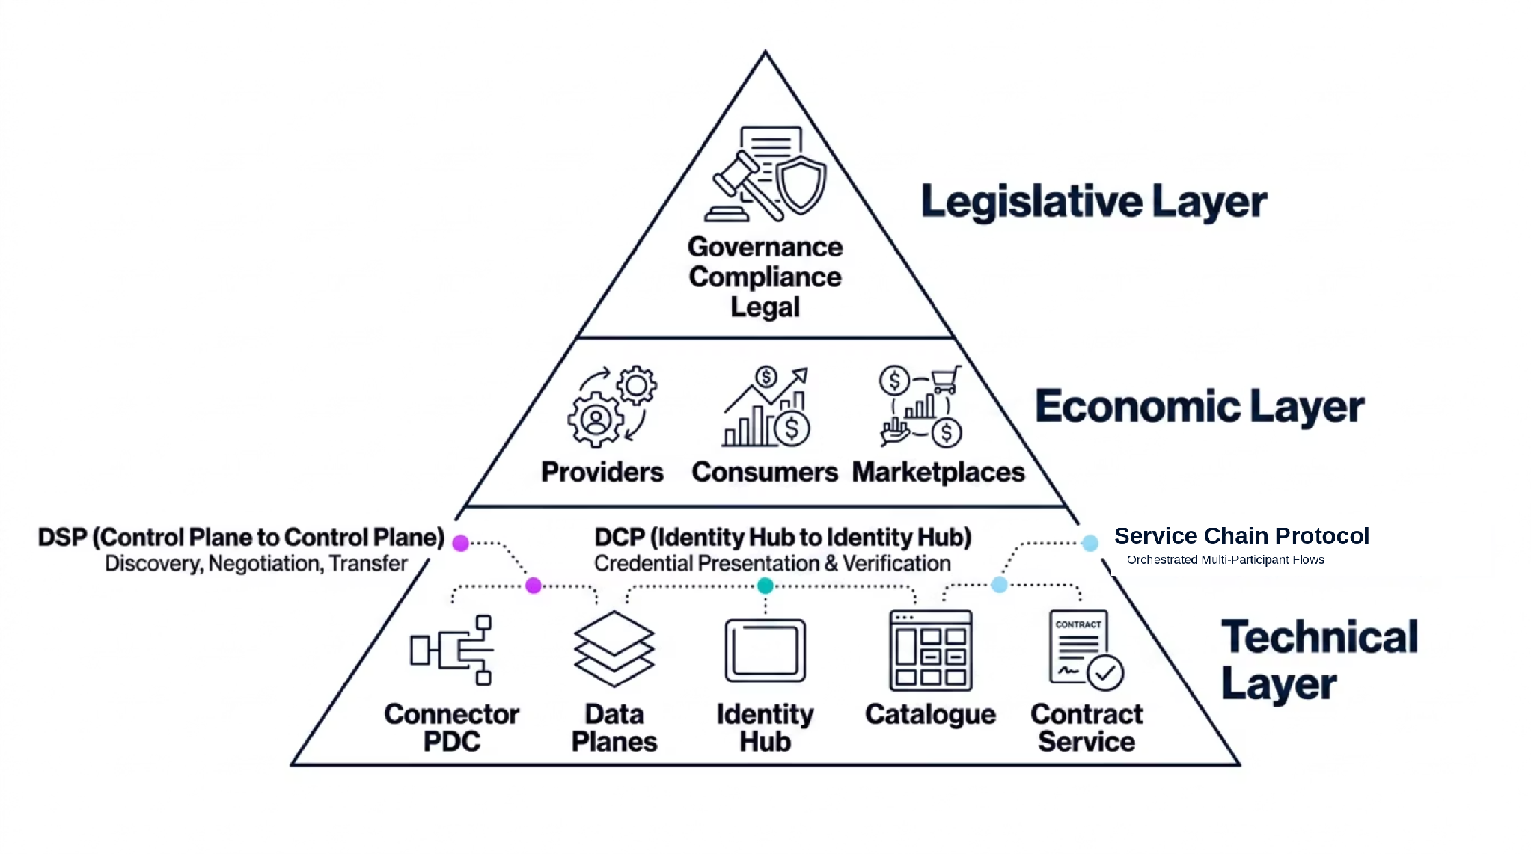

The Prometheus-X Architecture
Five building blocks, consent-driven data sharing via PDI
PDC Connector
Data Planes
Identity Hub
Catalogue
Peer-to-peer data exchange
Where data actually lives
Credential management
Federated discovery
Contract Service
Automated agreements
Notes:
The Prometheus-X Architecture: Five Building Blocks
The Prometheus-X open source stack consists of five building blocks and a consent-driven approach centred on the PDI. The five building blocks: PDC Connector for peer-to-peer data exchange, Data Planes where data actually lives, Identity Hub for credential management, Catalogue for federated discovery, and Contract Service for automated agreements.
Prometheus-X implements the DSP (Dataspace Protocol) as an interoperability protocol for discovery, negotiation, and transfer. The key differentiator is the PDI (Personal Data Intermediary), a consent-driven personal data sharing service where individuals manage their consents from a single place. DCP (Decentralised Claims Protocol) handles credential-based identity verification. Service chains enable multi-participant data flows orchestrated across organisations.
The components are connector (PDC), data planes, identity hub, catalogue, and contract service.

Slide 6
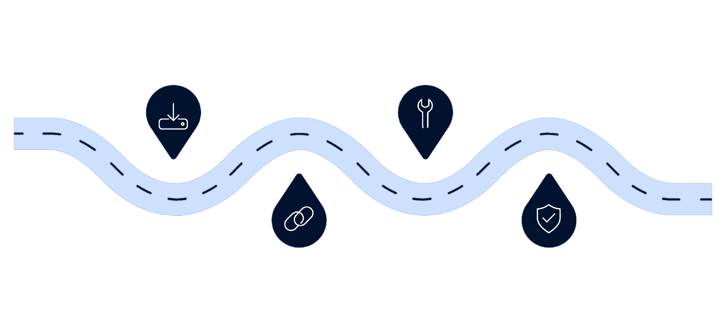
Collection ≠ Value Creation
The Data Journey in a Data Space
Ingest
Transform
Collect data with provenance from many sources
Harmonize and prepare data for analytics
Align
Assure
Apply semantic standards for interoperability
Run quality checks to ensure trustworthiness
Every step in the data journey adds value and builds trust. Data scientists operate across all five stages, not just the analytics layer. Understanding the full journey is key to building reliable, reusable pipelines in a data space.
Notes:
The Data Journey in a Data Space
The data journey in five steps, and the central point: collection does not equal value creation. Step 1: data is collected from diverse sources with provenance. Step 2: semantic standards make data interoperable across organisations.
Step 3: transformation and harmonisation prepare data for analytics. Step 4: quality assurance ensures trustworthiness and veracity. Step 5: results are shared back as new data offerings in the ecosystem. Every step in the data journey adds value and builds trust.
This is the core idea that accompanies you through the entire training.

Slide 7
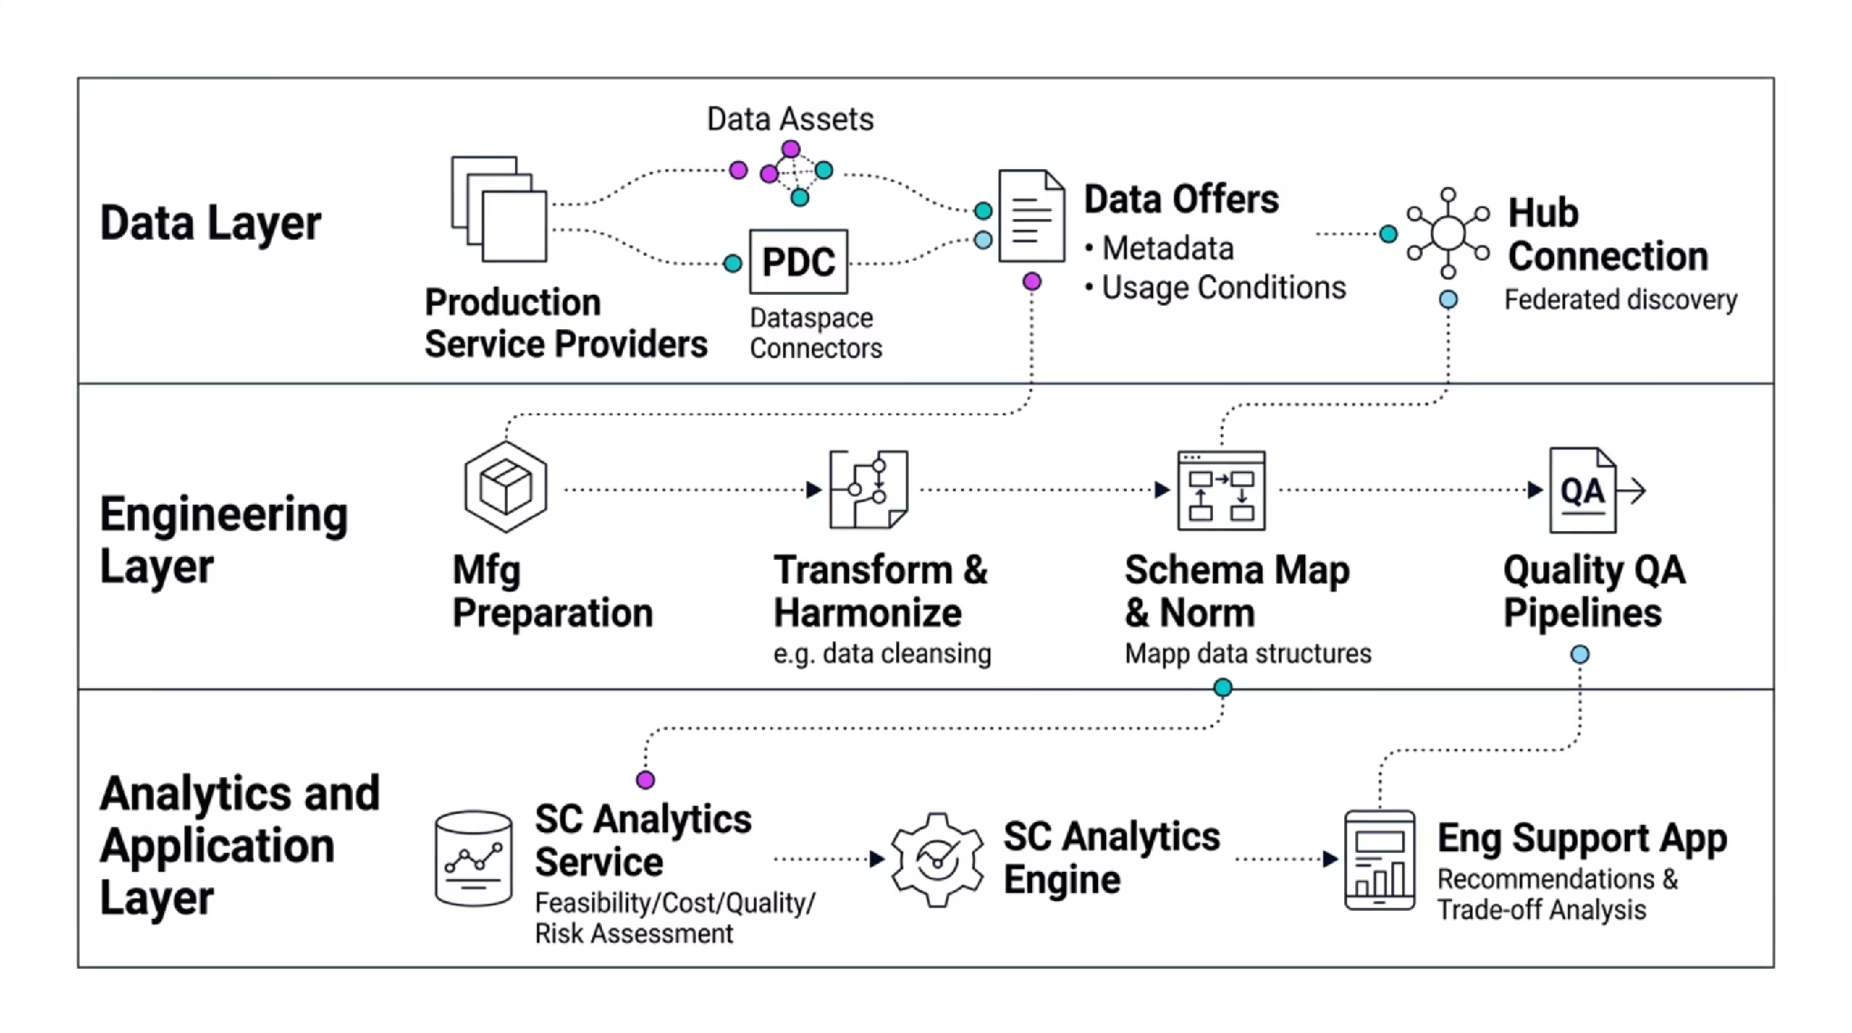

Data Flow in Practice
Sovereign data sharing across organizational boundaries: data stays at the source, only metadata and governance signals traverse the network.
Notes:
Data Flow in Practice
This slide shows the concrete data flow across three layers. The data layer: assets from multiple sources with Dataspace Connectors (PDC), metadata and usage conditions flowing into the hub. The transformation layer: data is transformed, harmonised, schema-mapped, and run through quality assurance pipelines.
The analytics and application layer: this is where actual value creation happens: supply chain analytics, feasibility analyses, recommendations, and trade-off analyses. The hub connection enables federated discovery and sovereign data exchange across organisational boundaries.
The data stays at the source; only metadata and results flow.

Slide 8


Data Flow
Data moves through the ecosystem via peer-to-peer connectors, never through a central intermediary. Governance, policy enforcement, and provenance tracking happen at every step of the transfer, ensuring full auditability and sovereignty throughout the pipeline.
The Control Plane governs the flow. The Data Plane carries the data. These are intentionally separated for security and sovereignty.
Notes:
Data Flow Diagram
This slide shows a graphical representation of the data flow. Take a moment to study the diagram. It visualises how data flows from sources through the data space hub, through transformation and quality checks, to the analytics engine.
The arrows indicate the direction of data flows. Note that the data itself remains at the sources; what flows through the hub is metadata, policies, and controlled access authorisations. The actual data transfer happens peer-to-peer through the data planes.

Slide 9

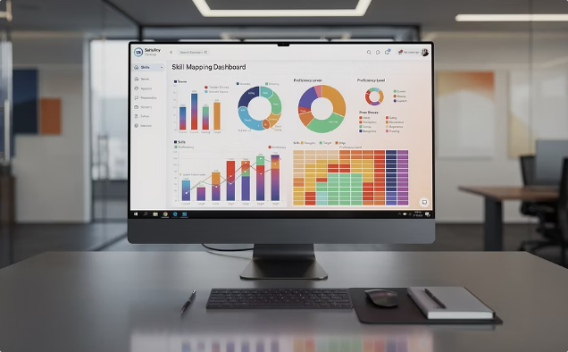
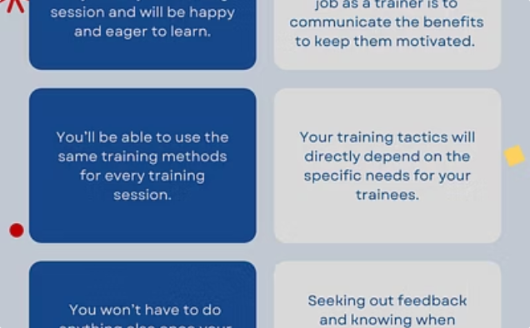

REFERENCE CASE
Skill Gap Analytics across Organizations
Schülerkarriere: Data Provider
Skill Analytics Service: Analytics Engine
imc: Data Consumer
Student career platform that shares anonymized student skill profiles into the data space under defined usage conditions.
L&D department uses skill gap analytics to design targeted training programs and personalized learning pathways.
Consumes profile data, maps skills to the ESCO framework, and identifies competency gaps using transformation pipelines.
Data flows through semantic transformation and quality checks. Each step adds metadata and provenance. Results are re-offered as new data assets with usage conditions.
Notes:
Reference Case: Skill Gap Analytics across Organisations
Our use case: Schülerkarriere as data provider shares anonymised student skill profiles. The Skill Analytics Service as analytics layer maps skills to ESCO and identifies competency gaps. imc as data consumer uses the results for designing training programmes.
The data flow model: data flows through semantic transformation and quality checks. Each step adds metadata and provenance. Results are re-offered as new data assets with their own usage conditions. This is the complete cycle: from raw data to actionable insights and back into the ecosystem.

Slide 10

Step 1: Data Ingestion & Connectors
How data enters the data space ecosystem
Data Sources
Connect databases, APIs, file systems, and IoT streams. Dataspace Connectors (PDC) provide standardized, protocol-compliant access to any source.
Data Assets
Data stays at the source. Only metadata and usage conditions are shared via the catalog; true data sovereignty.
Each dataset becomes an Asset with associated metadata, a DataAddress pointer, and usage conditions defining who can access it and how.
Ingestion Patterns
Pull: query on demand. Push: scheduled batch delivery. Stream: continuous flow from sensors or live applications.
Notes:
Step 1: Data Ingestion & Connectors
How data enters the data space ecosystem. Data sources are connected via connectors: databases, APIs, file systems, IoT streams. Dataspace Connectors (PDC) provide standardised access. Each dataset becomes an asset with metadata, a DataAddress, and usage conditions that define who can access it.
Three ingestion patterns: pull for queries on demand, push for batch deliveries, stream for continuous data flows. The central principle: data stays at the source.
Only metadata and usage conditions are shared via the catalogue.

Slide 11

Step 2: Semantic Standards & Ontologies
Making data interoperable across organizations and systems
xAPI
JSON-LD
Learning experience traces and activity statements. Standardizes how learner actions are recorded and shared across platforms.
Linked data format for machine-readable semantic context. Embeds meaning directly into data structures for automated reasoning.
RDF
ESCO & ROME
Knowledge graphs and ontology relationships. Enables rich semantic modeling and cross-system data linking.
European skills and competencies framework plus French job classification. Domain-specific extensions support custom ontologies.
Without shared semantics, data from different organizations cannot be compared, combined, or analyzed. Semantic alignment is the foundation of every successful data space.
Notes:
Step 2: Semantic Standards & Ontologies
Without shared semantics, data from different organisations cannot be compared, combined, or analysed. Semantic alignment is the foundation of every successful data space. Three core standards: xAPI for learning experience traces and activity statements.
JSON-LD for machine-readable semantic context as linked data. RDF for knowledge graphs and ontology relationships. Classification frameworks: ESCO as the European standard for skills, competences, and qualifications. ROME as the French job classification framework.
Plus custom ontologies for domain-specific extensions. Your task as data scientists: prepare data so that it can be linked across organisations via semantic relationships.

Slide 12
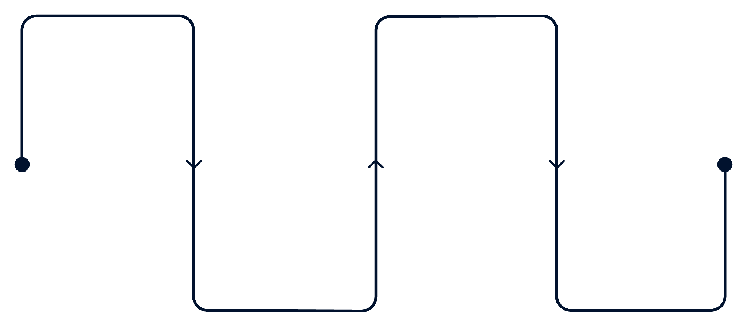
Step 3: Data Transformation & Preparation
Map
Enrich
Schema alignment and ontology mapping
Semantic enrichment and metadata addition
Transform
Validate
Format conversion and normalization
Quality checks and verification
Pipeline Value Principles
Why Reusability Matters
Quality checks at every pipeline stage
Metadata tracks provenance and lineage
Build reusable transformation services others can chain
Aligned with Prometheus-X transformation services
Each transformation service you build can be published as an offering in the catalog. Other participants can chain your service into their own pipelines, multiplying the value of your work across the entire ecosystem without redundant effort.
Notes:
Step 3: Data Transformation & Preparation
The transformation pipeline in four steps. Map: schema alignment and ontology mapping, your data is aligned to shared standards. Transform: format conversion and normalisation. Enrich: semantic enrichment and metadata addition.
Validate: quality checks and verification. Two core principles: first, quality checks at every pipeline stage, with metadata tracking provenance and lineage. Second, build reusable transformation services that other participants can chain.
This is aligned with the Prometheus-X transformation services. Your pipelines are not one-off scripts; they become services in the ecosystem.

Slide 13
Step 4: Metadata & Catalog Management
Discoverable, understandable, reusable data
Technical Metadata
Semantic Metadata
Format, schema, size, encoding, update frequency, API endpoints, data lineage, and provenance records.
Ontology references (ESCO, ROME), domain classification and tags, semantic relationships to other data assets.
Contractual Metadata
Catalog Integration
ODRL usage conditions, license type, access restrictions, consent requirements, and scope definitions.
Register in the Prometheus-X catalog to enable federated discovery across spaces and participant organizations.
Rich metadata → enables discovery → builds trust → drives reuse → across the entire ecosystem
Notes:
Step 4: Metadata & Catalogue Management
For data to be discoverable, understandable, and reusable, you need three types of metadata. Technical metadata: format, schema, size, encoding, update frequency, API endpoints, data lineage and provenance. Semantic metadata: ontology references such as ESCO and ROME, domain classification and tags, semantic relationships to other assets.
Contractual metadata: usage conditions as ODRL policies, licence type and access restrictions, consent requirements and scope. The chain is: rich metadata enables discovery, discovery builds trust, trust enables reuse. Everything is registered in the Prometheus-X catalogue and enables federated discovery across data spaces.

Slide 14
Step 5: Data Quality & Veracity
Ensuring accuracy, completeness, and trust
Quality Dimensions
Provenance & Lineage
Track where data comes from, how it was transformed, and who processed it. The Data Value Chain Tracker provides end-to-end visibility across the entire data journey.
Accuracy: correctness of values
Completeness: no missing fields
Quality in Multi-Party Environments
Timeliness: data is current
Consistency: no contradictions
Verify provider reliability (source trust)
Run automated quality checks (validation)
Monitor quality continuously
Feedback loops to providers (remediation)
Prometheus-X Data Veracity Assurance validates data integrity at each pipeline step.
Notes:
Step 5: Data Quality & Veracity
Four quality dimensions: accuracy: correctness of values. Completeness: no missing fields. Timeliness: data is current. Consistency: no contradictions. Provenance and lineage: track where data comes from, how it was transformed, and who processed it.
The Data Value Chain Tracker provides end-to-end visibility across the entire data journey. In multi-party environments with multiple organisations: source trust verifies provider reliability. Validation rules automate quality checks.
Monitoring enables continuous quality tracking. Remediation creates feedback loops back to providers. Prometheus-X Data Veracity Assurance validates data integrity at each step.

Slide 15


Step 6: Governance & Policies for Data
How governance shapes what data you can access and share
1
Access Policies
Policy Examples
Define who can discover and access your data assets: by organization type, credential, or membership status.
Open Data: available to all space members
Restricted: only verified research institutions
Purpose-limited: analytics only, no redistribution
Time-limited: access expires after 90 days
2
Usage Policies
Define what can be done with data after access: analytics only, no redistribution, or purpose-limited use cases.
ODRL (Open Digital Rights Language) defines machine-readable policies. PDC Connectors enforce them automatically; no manual review required.
3
Consent Management
Human-centric control over personal data, required for any individual-level data exchange under GDPR.
As a data scientist, understand the policies that govern your data before building analytics pipelines.
Notes:
Step 6: Governance & Policies for Data
Governance shapes what data you can access and share. Three governance layers: access policies define who can discover and access your data assets (open data for all members, restricted only for verified research institutions).
Usage policies determine what can be done with data after access (purpose-limited, for example analytics only, no redistribution). Access policies can also be time-limited (for example access expires after 90 days). Consent management gives human-centric control over personal data, required for any individual-level data exchange under GDPR.
ODRL as Open Digital Rights Language defines machine-readable policies that connectors enforce automatically. As a data scientist, you must understand the policies that govern your data before building analytics pipelines.

Slide 16



Step 7: Publish Data & Re-Offer Results
Making your data and analytics results available to the ecosystem
1: Register Data Asset
2: Set Usage Conditions
3: Re-Offer Results
Define metadata: type, domain, schema, quality level, and provenance. Point to where data actually lives on the Data Plane.
Define who can access the asset, for what purpose, and under which constraints. ODRL policies are enforced automatically by the PDC.
Analytics results become new data assets. Publish insights back to the catalog so others can discover, access, and build upon your work.
The actual data stays on the Provider's Data Plane. The Control Plane holds only governance metadata, ensuring sovereignty at every step.
Notes:
Step 7: Publish Data & Re-Offer Results
In three steps, your data and analytics results become available. First: register data asset: define metadata such as type, domain, schema, quality level, and provenance. Point to where the data actually lives. Second: set usage conditions: define who can access, for what purpose, and under which constraints.
ODRL policies are enforced automatically. Third: re-offer results: your analytics results become new assets. Publish insights back to the catalogue for others to discover and reuse. The central principle: the actual data stays on the provider's data plane.
The control plane holds only the governance information.

Slide 17

Step 8: Consume & Integrate Data
Accessing data for analytics and AI pipelines
Data Scientist Workflow
How Each Step Works
01
Discover: Query any Provider's DSP endpoint. Filter by semantic tags, quality level, or data type. Review policy constraints before requesting access.
Negotiate: Automated policy check: credentials verified, contract agreed in seconds. Fully automated, no manual approval required.
Integrate: Receive data via secure transfer from the Provider's Data Plane. Feed directly into analytics pipelines using your familiar tools.
Discover relevant datasets via semantic search and policy filters
02
Check data quality scores and provenance records
03
Negotiate access automatically via DSP protocol
The data space gives you standardized access to data across organizational boundaries with built-in governance.
04
Integrate data into your Pandas, Spark, or notebook pipeline
05
Re-offer enriched results as new assets in the catalog
Notes:
Step 8: Consume & Integrate Data
The data scientist workflow in a data space in five steps: discover relevant datasets, check quality and provenance, negotiate access automatically, integrate into your pipeline, re-offer enriched results. Technically: discover via the provider's DSP endpoint, filter by semantic tags, quality level, or data type.
Negotiate access: automated policy check, credentials verified, contract agreed. This takes seconds, fully automated. Integrate and analyse: data is received via secure transfer and fed into your analytics pipelines. The data space gives you standardised access to data across organisational boundaries with built-in governance.

Slide 18
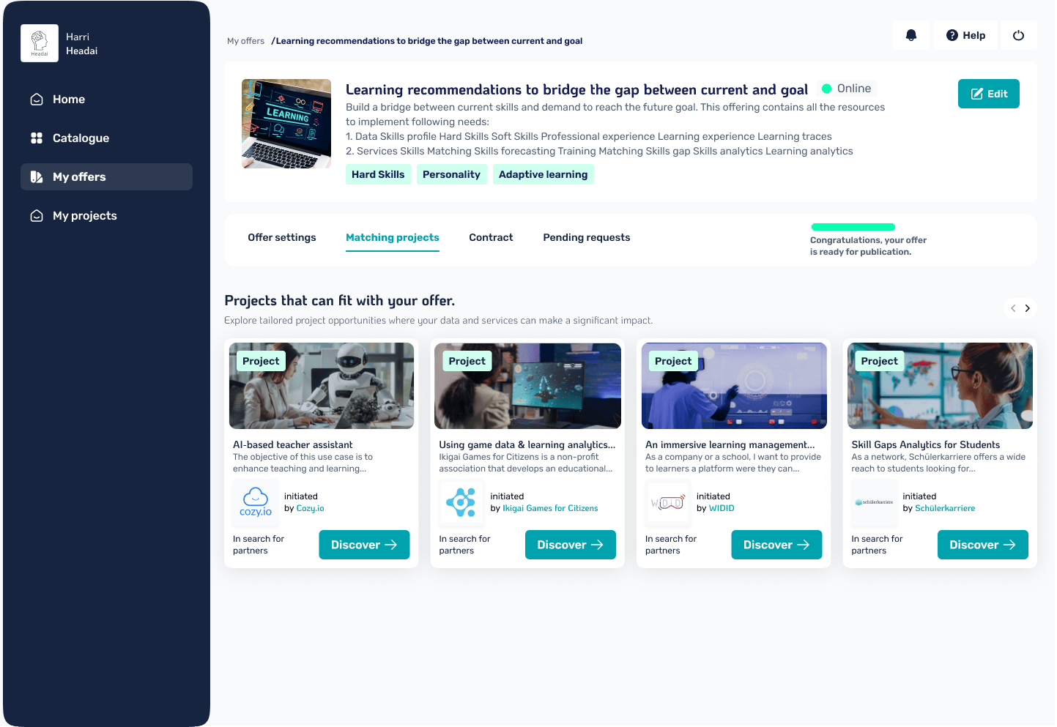
VisionsTrust
Your Data Access & Consent Platform
1
2
Catalogue
Contract Service
Browse available datasets, discover offers across organizations, view metadata and data samples before requesting access.
Automated data agreements with policy-based access control. No manual approvals; negotiation happens in seconds via the DSP protocol.
3
Consent Service
Personal data governance with user-level consent flows. GDPR-compliant data exchange with full auditability for every consent decision.
Notes:
VisionsTrust: Your Data Access & Consent Platform
VisionsTrust is the reference implementation of the Prometheus-X open source stack. Three services: the catalogue for browsing available datasets, discovery across organisations, viewing metadata and samples. The contract service for automated data agreements with policy-based access control, no manual approvals needed.
The consent service for personal data governance with user-level consent flows, enabling GDPR-compliant data exchange. These are the three services through which you as data scientists interact with the data space.

Slide 19
How Data Scientists Access Data
The complete flow from discovery to data in your notebook
Discover
1
Browse the VisionsTrust Catalogue for datasets and service offers. Filter by domain, quality, semantic tags, and policy type.
Negotiate
2
Contracts are negotiated automatically. Policies evaluate your organization's credentials and access rights in real time.
Consent
3
For personal data, user consent is collected via the PDI consent service before any data exchange is authorized.
Exchange
4
Data flows peer-to-peer through the PDC. You receive data via a secure endpoint and access token, no central intermediary.
Analyze
5
Ingest into your pipeline: Pandas, Spark, Jupyter notebooks. Sovereign data, your familiar tools, no workflow disruption.
Notes:
How Data Scientists Access Data
The complete flow from discovery to data in your notebook. Five steps: discover: browse the VisionsTrust catalogue for datasets and service offers across organisations. Negotiate: contracts are negotiated automatically, policies evaluate your organisation's credentials.
Consent: for personal data, user consent is collected via the PDI consent service before exchange. Exchange: data flows peer-to-peer through the PDC, you receive it via endpoint and access token. Analyse: ingest into your pipeline: Pandas, Spark, notebooks.
Sovereign data, your familiar tools. The point: you do not need to re-learn. Your analytics tools stay the same; the access to data becomes standardised and governance-compliant.

Slide 20
Resources & the Catalogue
What you see when browsing data in VisionsTrust
Name & Type
Description & Location
Display name and data/service classification visible in the catalogue browser. Helps you quickly identify asset category and scope.
What the data contains and the geographic storage region, critical for compliance checks under GDPR and data residency rules.
Sample Extract
Personal Data Flag
A JSON sample showing data structure so you can assess schema compatibility before requesting access or building your pipeline.
Triggers consent requirements automatically. If the resource is flagged as personal data, user consent must be collected before exchange is authorized.
Notes:
Resources & the Catalogue: What You See When Browsing
When browsing data in the VisionsTrust catalogue, you see four core fields. Name and type: display name and classification as data or service resource. Description and location: what the data contains and where it is geographically stored, relevant for compliance checks.
Sample extract: a JSON sample showing data structure so you can assess the schema before requesting access. Personal data flag: marks whether consent requirements apply. If flagged, user consent is required before any exchange.
These four fields help you quickly evaluate whether a dataset is relevant and accessible for your analysis.

Slide 21
Four Data Exchange Protocols
Which protocol applies depends on the data type and use case
B2B Non-Personal
Consent-Driven
Direct organization-to-organization data sharing. Contract-based authorization only; no consent flow required. Fastest path to data access.
Individual consent required before exchange. The endpoint must include a userId parameter. Resource must be flagged as personal data in metadata.
API Consumption
Service Chains
Data provider consumes a service rather than receiving raw data. Resource is marked as API payload. The service response is sent back to the provider's endpoint.
Multi-participant workflows combining Data + Service + Infrastructure providers. Enables complex pipeline orchestration. Requires PDC v1.9.0 or higher.
Notes:
Four Data Exchange Protocols
Which protocol applies depends on the data type and use case. B2B non-personal: direct organisation-to-organisation data sharing, contract-based authorisation only, no consent needed. Consent-driven: individual consent required, endpoint must include userId, resource flagged as personal data.
API consumption: data provider consumes services, resource marked as API payload, response sent back to provider. Service chains: multi-participant workflows with data plus service plus infrastructure, requires PDC v1.9.0+.
For the skill gap use case, we use consent-driven because student profiles contain personal data.

Slide 22
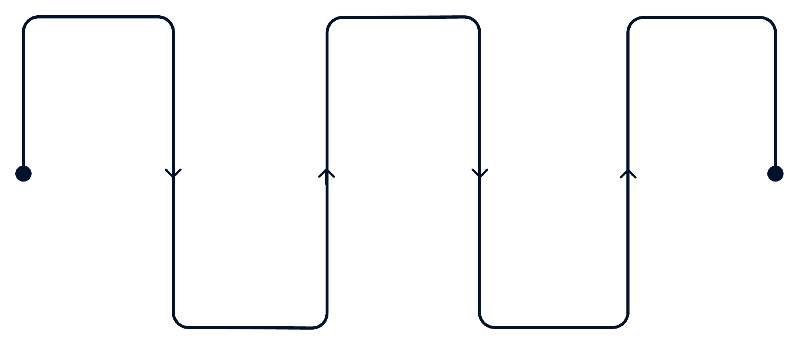

Consent Flow for Personal Skills Data
When your analysis requires individual-level data
Flag Resource
User Consents
Data Available
Provider marks data as personal
Individual grants consent via PDI
Personal data flows to endpoint
Exchange Authorized
Privacy Notice
Consent service generates notice
PDC confirms and authorizes transfer
Never attempt to access personal data without a completed consent flow. The PDC enforces this at the protocol level; unauthorized requests will be rejected automatically.
Notes:
Consent Flow for Personal Skills Data
When your analysis requires individual-level data, the consent flow kicks in with five steps. The provider flags the resource as personal data in the VisionsTrust metadata configuration. The consent service automatically generates a privacy notice for the data subject (in our case the learner).
The individual grants consent via the PDI consent interface before any data flows. The PDC receives consent confirmation and authorises the secure peer-to-peer data transfer. Personal data flows to your endpoint with the userId parameter for per-user data ingestion.
This flow is not optional; it is a GDPR requirement for personal data.

Slide 23
Testing Your Data Flows
VisionsTrust Tech Space: validate data exchange before going to production
1
2
3
4
Exchange Tests
Ping Connector
Log Viewer & Export
Common Errors
Validate all four protocol types: B2B Non-Personal, Service Chain, API Consumption, and Consent-Driven flows in an isolated test environment.
Verify PDC connectivity and confirm that your data connector responds correctly to incoming requests before registering assets in the catalog.
Monitor exchange logs in real time and download CSV exports for detailed troubleshooting of failed or stalled transfers.
Missing tech config: Set REST source + endpoint URL. Missing PII declaration: Enable the personal data flag on resources requiring consent.
Notes:
Testing Your Data Flows
VisionsTrust offers a Tech Space for validating data exchanges before production. Exchange tests: validate all four protocol types: project exchange, service chain, API consumption, consent-driven. Ping connector: verify PDC connectivity and check that your data connector responds correctly to requests.
Log viewer and export: monitor exchange logs in real time and download CSV exports for detailed troubleshooting. Common errors: missing tech config: set REST source and endpoint URL. Missing PII declaration: enable personal data flag and add userId parameter.
Test thoroughly before going to production.

Slide 24
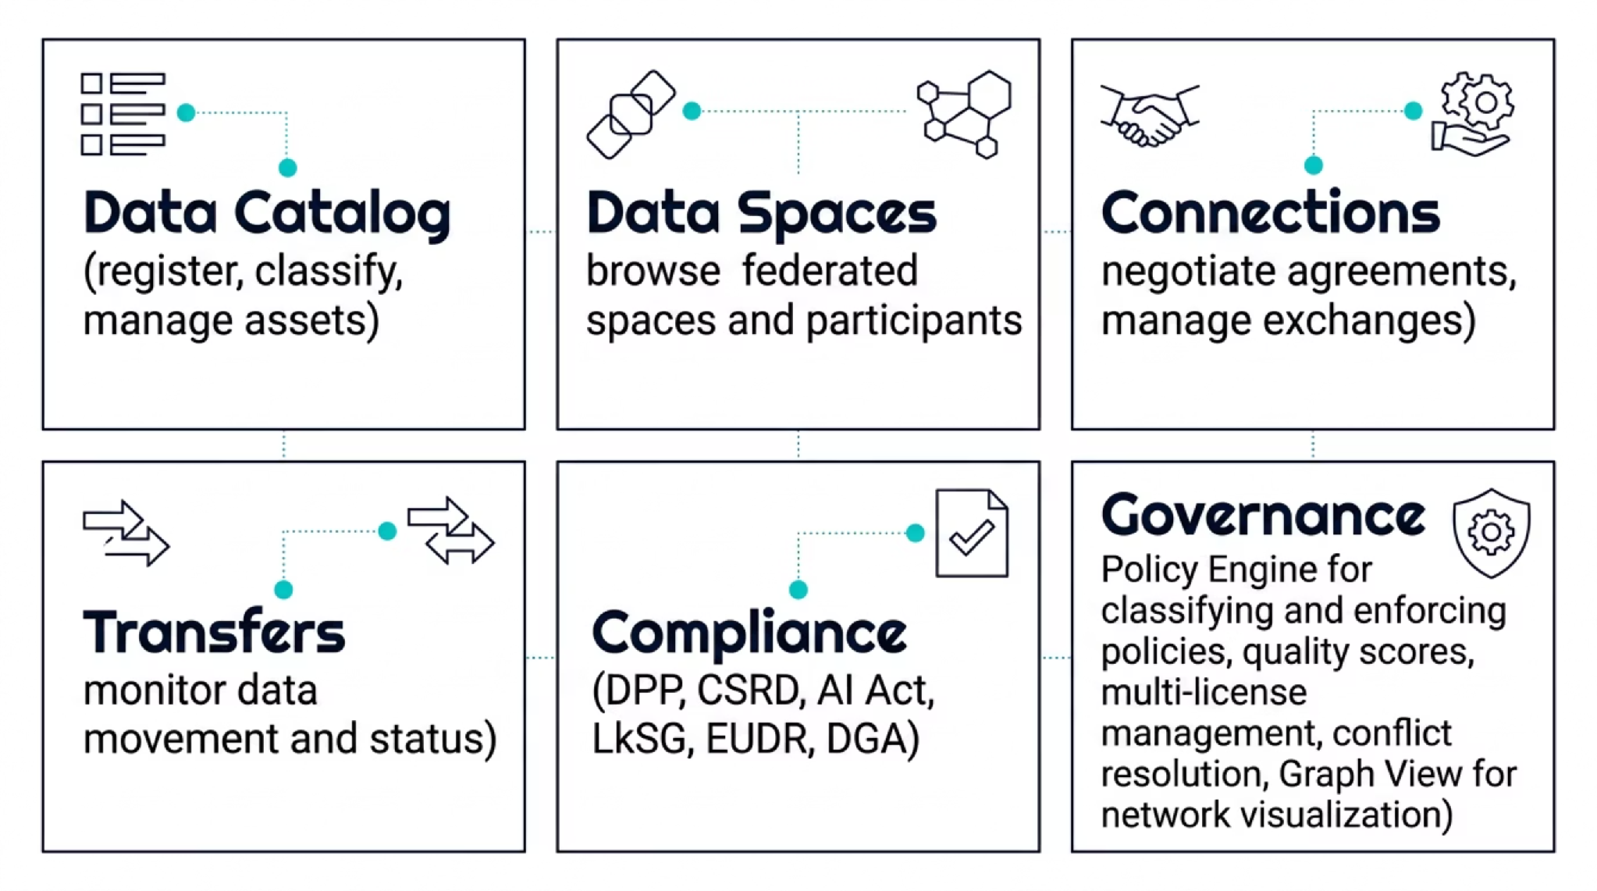
Operational Interfaces
Comprehensive tools for managing data spaces in production
Notes:
Operational Interfaces
An overview of comprehensive tools for managing data spaces in production. Eight areas: data catalogue for asset registration and classification. Data spaces for browsing federated spaces and participants. Connections for agreement negotiation and exchange management.
Transfers for monitoring data movement and status. Compliance for DPP, CSRD, AI Act, LkSG, EUDR, and DGA. Governance for classification, policy enforcement, and quality scores. Policy engine for multi-licence management and conflicts.
Graph view for network visualisation of the ecosystem.

Slide 25
Privacy-Preserving Data Processing
Responsible data use without sacrificing utility
Personal data in data spaces requires special handling. Privacy-preserving techniques enable rich analytics while protecting individual rights and maintaining regulatory compliance.
Core Techniques
Advanced Approaches
Anonymization: remove identifying information permanently
Federated Processing: compute at the data source, never move raw data
Differential Privacy: add calibrated statistical noise
Secure Multi-Party Computation: collaborative analytics without data exposure
Pseudonymization: replace identifiers with reversible tokens
Synthetic Data: statistically equivalent datasets with no real individuals
Key principle: Balance utility and privacy. Choose the right technique for each use case; there is no one-size-fits-all solution.
Notes:
Privacy-Preserving Data Processing
Personal data in data spaces requires special handling. Privacy-preserving techniques enable analytics while protecting individuals. Three main techniques: anonymisation removes identifying information permanently. Pseudonymisation replaces identifiers with reversible tokens.
Synthetic data creates statistical equivalents. Three advanced approaches: federated processing computes directly at the data source. Differential privacy adds calibrated noise. Secure computation enables multi-party computation.
The core principle: balance utility and privacy. Choose the right technique for each use case. For the skill gap use case, Schülerkarriere uses anonymisation of profiles before sharing.

Slide 26
Validate the Full Data Flow
Ingestion
Semantics
Data sources are connected and accessible via PDC connectors
Standards applied: data is interoperable across organizations
Quality
Governance
Accuracy, completeness, and provenance verified and recorded
Contract agreement is properly configured and FINALIZED
Analytics
Re-offering
Pipeline produces valid, reproducible insights from the data
Results are published as new assets with usage conditions
Data Flow Checklist
Can data be discovered via catalog with semantic search?
Are semantic standards correctly applied: xAPI, JSON-LD, ESCO?
Does the Contract Agreement complete successfully (status: FINALIZED)?
Are usage conditions and consent properly enforced by the PDC?
Are audit records generated for governance and compliance tracking?
Notes:
Validate the Full Data Flow
Six validation steps for the end-to-end check. Ingestion: data sources connected and accessible. Semantics: standards applied, data interoperable. Quality: accuracy, completeness, provenance verified. Governance: contract agreement properly configured.
Analytics: pipeline produces valid insights. Re-offering: results published as new assets. The data flow checklist: can data be discovered via catalogue with semantic search? Are semantic standards correctly applied (xAPI, JSON-LD)? Does the contract agreement get created successfully (FINALIZED)? Are usage conditions and consent properly enforced? Are audit records generated for governance and compliance tracking?

Slide 27
Where Data Integration Often Fails
These are not edge cases. These are the most common reasons data integration in data spaces fails, and every one of them is preventable.
✗ Skipping Semantic Standards
✗ Missing Metadata & Catalog Registration
Ingesting data without applying ontology mapping makes cross-organizational analysis impossible. Semantics must be applied at ingestion, not retrofitted later.
Unenriched data cannot be discovered or reused. Catalog registration is not optional; it is what makes your asset visible to the ecosystem.
✗ No Quality or Provenance Tracking
✗ One-Off Transformations
Data without verified quality and lineage is not trusted by other participants. Quality assurance is a prerequisite for sharing, not an afterthought.
Ad hoc scripts do not scale in a data space. Build reusable, publishable transformation services that others can integrate into their own pipelines.
✗ Ignoring Consent & Usage Conditions
✗ Analytics Without Re-offering
Personal data exchanged without proper consent flows violates GDPR and will be blocked by the PDC at the protocol level.
Building isolated pipelines wastes the ecosystem's potential. Publish your results: analytics outputs are valuable assets for others to discover and reuse.
Notes:
Where Data Integration Often Fails
Six typical failures, and these are not edge cases but the most common reasons data integration in data spaces fails. Ingesting data without applying semantic standards. Skipping metadata enrichment and catalogue registration.
Ignoring data quality checks and provenance tracking. Treating transformation as a one-off script instead of a reusable pipeline. Forgetting consent and usage conditions for personal data. Building analytics in isolation without re-offering results.
Each of these points is a project killer. Go through the list and honestly check whether you have covered all points in your own context.

Slide 28

The Data Scientist Toolkit
Standards & Semantics
Platforms & Tools
Quality & Governance
xAPI, JSON-LD, RDF
ESCO, ROME frameworks
ODRL machine-readable policies
Linked Data principles
VisionsTrust Platform
Prometheus-X Catalog
Dataspace Connectors (PDC)
Data Plane SDKs
Data Veracity Assurance
Value Chain Tracker
Consent management flows
PDC Governance & Quality API
Core Principle: Invest in semantic alignment and data quality. The infrastructure handles discovery, trust, and transfer automatically; your job is to ensure the data is meaningful and trustworthy.
Notes:
The Data Scientist Toolkit
Three tool categories you need to know. Standards and semantics: xAPI, JSON-LD, RDF as data formats. ESCO and ROME as classification frameworks. ODRL for machine-readable policies. Linked data principles as design philosophy.
Platforms and tools: VisionsTrust Platform for catalogue browsing, Prometheus-X catalogue for discovery, Dataspace Connectors (PDC) for data access, data plane SDKs for integration. Quality and governance: data veracity assurance for integrity checks, value chain tracker for provenance, consent management via VisionsTrust, PDC Governance and Quality API.
The core principle: invest in semantic alignment and data quality. The infrastructure handles discovery, trust, and transfer automatically.

Slide 29
Apply This to Your Data Context
Use these five questions to map your own data assets, pipelines, and governance requirements into the data space model.
What data do you have?
What standards apply?
What transformations are needed?
Inventory your data assets, formats, schemas, and quality levels. Understand what you own before deciding what to share.
Map your data to semantic standards such as xAPI, ESCO, and JSON-LD. Identify gaps where ontology alignment work is needed.
Design reusable pipelines for schema mapping, semantic enrichment, and quality assurance. Build once, publish for others.
What governance applies?
What results can you re-offer?
Define usage conditions, consent requirements, and privacy needs before you publish. Governance is designed up front, not added later.
Plan how your analytics outputs become new data offerings. Every insight is a potential asset for the broader ecosystem.
Notes:
Exercise: Apply This to Your Data Context
Now it is your turn. Five questions for your own data context: what data do you have: inventory your assets, formats, schemas, and quality levels. What standards apply: map your data to semantic standards like xAPI, ESCO, or JSON-LD.
What transformations are needed: design reusable pipelines for mapping, enrichment, and quality. What governance applies: define usage conditions, consent requirements, and privacy requirements. What results can you re-offer: plan how your analytics outputs become new data offerings in the ecosystem.
Take five minutes and sketch out answers for your own work context.

Slide 30
What to Remember as a Data Scientist
Five key takeaways for working with data in data spaces
Think in Data Flows, Not Databases
The data journey model (Data, Transformation, Analytics, Application) is your primary mental framework.
Re-offering Completes the Cycle
Your analytics results become valuable assets for others. Publishing outputs is not optional; it is what makes the ecosystem self-reinforcing.
Governance Enables Sharing
ODRL policies and consent flows make it safe and legal to share sensitive data. Governance is the mechanism, not the obstacle.
Quality Creates Trust
Data quality, provenance, and lineage are what make data reusable by others. Quality is a prerequisite for participation.
Semantics Are the Foundation
Without shared ontologies and standards, data from different organizations cannot be compared, combined, or analyzed at scale.
Notes:
Key Takeaways: What to Remember as a Data Scientist
Five key messages. First: semantics are the foundation: without shared standards, data from different organisations cannot be combined. Second: quality creates trust: data quality, provenance, and lineage are what make data reusable.
Third: governance enables sharing: policies and consent make it safe to share sensitive data. Fourth: re-offering completes the cycle: your analytics results become valuable assets for others. Fifth: think in data flows, not databases: the data journey model: data, transformation, analytics, application.
Thank you for participating, questions?

Slide 31
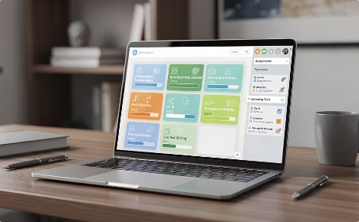

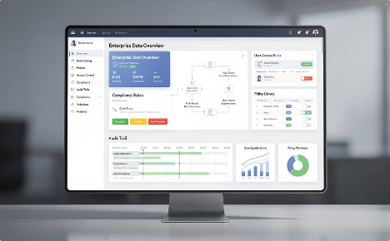

Resources & Next Steps
EDGE-Skills Curriculum
Prometheus-X Documentation
VisionsTrust Platform
Hands-On Guides
Module 4: Data & Semantics (Data-deep): the full deep-dive module aligned with this training session.
Catalog, governance, compliance tooling, and live data exchange, your operational environment for data space participation.
Learning paths, concepts, and practical exercises at prometheus-x.org, including the 4-layer reference implementation.
Building blocks, standards, and architecture references for all Prometheus-X components and protocols.
EDGE-Skills Data Scientist Training · Prometheus-X · VisionsTrust
Notes:
Resources & Next Steps
To close, the key resources for your continued work. The EDGE-Skills curriculum, specifically Module 4 on data and semantics (that is your data-deep module). The Prometheus-X documentation for building blocks, standards, and architecture.
The VisionsTrust Platform for catalogue, governance, compliance, and data exchange. The prometheus-x.org site for learning paths, concepts, and hands-on guides. And the Prometheus-X reference implementation at prometheus-x.org for the 4-layer data flow: data, transformation, analytics, application.
These resources form your reference for practical implementation.

